Slide 1
Asymmetric copula in multivariate flood frequency analysis
Hannes Grün, Robin Schüttpelz

Slide 2
Relevance
Floods: Among most severe natural hazards worldwide. Floods in Bavaria in 2024 alone have caused ~ 4 bn € damages^{[1]}.
Multivariate flood analysis: Interdependence of flood event characteristics.
Asymmetric copula functions: Varying strength of dependence between variables, allowing more accurate modelling[2].

Slide 3
Dependence Structure
Relevant Variables: Flood peak (P), Duration (D), Volume (V).
Influences on Dependencies: P affects dependence structure between D & V.
Goal by Grimaldi & Serinaldi (2006): Trivariate joint distribution of flood event variables using fully nested or asymmetric Archimedean copula functions.

Slide 4
Research Question
Reproduction of methodology by Grimaldi & Serinaldi (2006) within in bavarian rivers.
Comparison of nested Archimedean copulas (NACs) with vine copulas for modeling multivariate flood dependencies.
Evaluation of the advantages of flood return periods in a multivariate statistical framework.

Slide 5
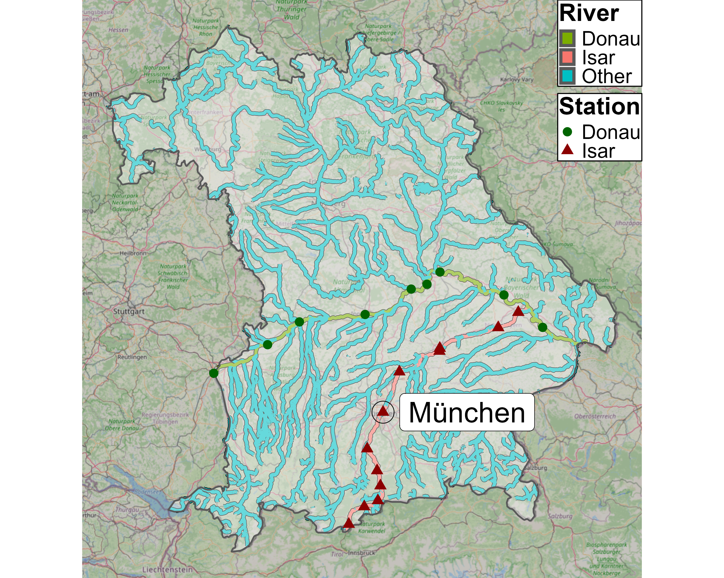
Data - Selection
GKD 2025

Slide 6
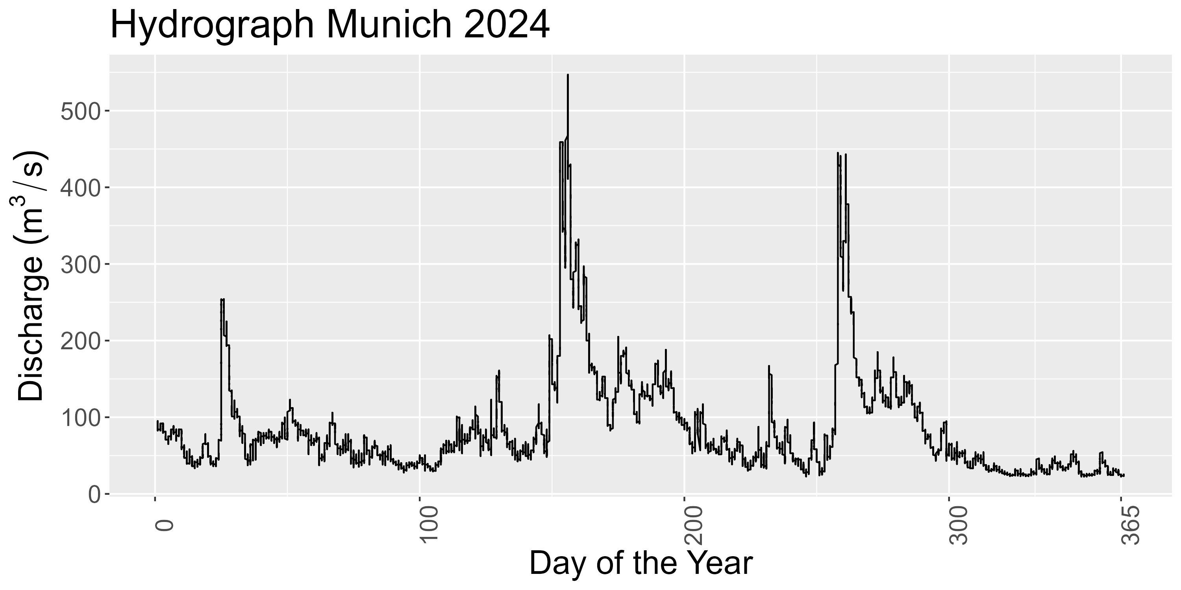
Data – Munich Station
Nival-Pluvial Regime: Peaks in spring (snowmelt) & late summer (heavy rainfall)

Slide 7
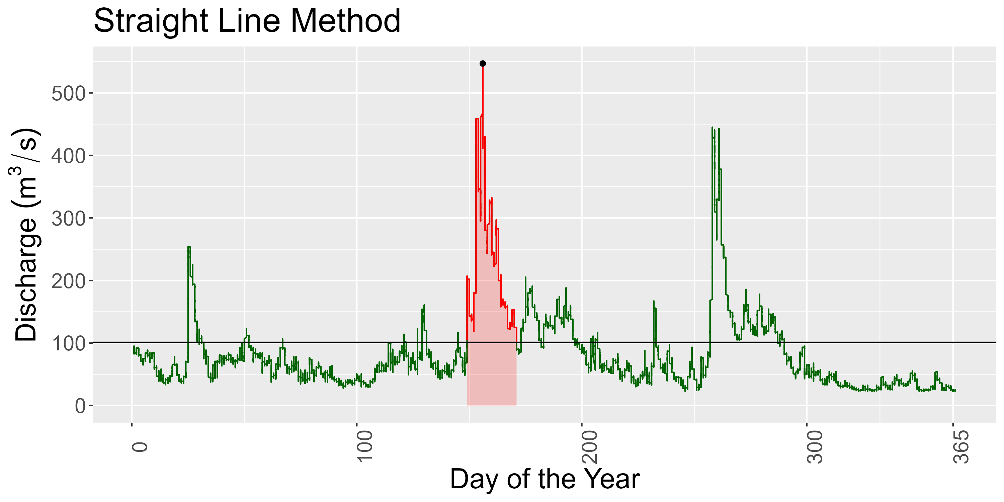
Data – Munich Station
Idea: Define highest flood event per year.
Issue: Absolute value thresholds not applicable for different stations.
Solution: 75%-Quantile approach.
Grimaldi & Serinaldi 2006
Notes:
Contrary to the paper, we do not use fixed threshold
Reason: Fixed threshold is not reasonable IMO bc we are intersted in the dependence strucutre
Dependence structure / correlation is scale independent
Exact values:
Peak: 547
Duration in days: 22.1
Vol in Mio: 446

Slide 8
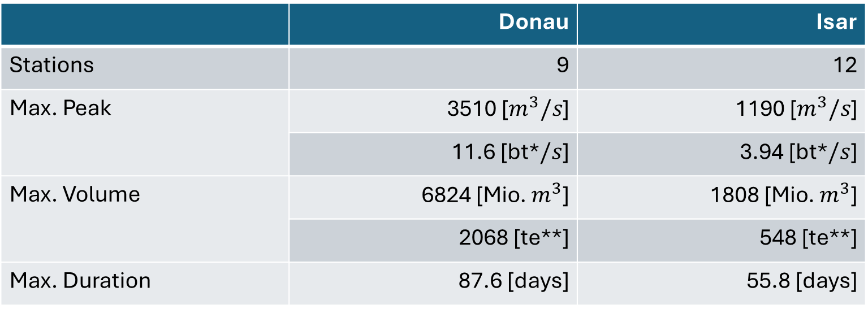
Data – Summary
 | Donau | Isar
Stations | 9 | 12
Max. Peak | 3510 [$m^{3}/s$] | 1190 [$m^{3}/s$]
 | 11.6 [bt*$/s$] | 3.94 [bt*$/s$]
Max. Volume | 6824 [Mio. $m^{3}$] | 1808 [Mio. $m^{3}$]
 | 2068 [te**] | 548 [te**]
Max. Duration | 87.6 [days] | 55.8 [days]
*bt denotes unit „bathtub“
**te denotes unit „Therme Erdingen“
Notes:
2 Rivers, 27 stations where: 6 have below 30 observations -> remove those bc pretty little infor for following methods
After removing: 2 Rivers, 21 stations: Donau: 9, Isar 12
Majority of stations have sample size of 54 with only 2 stations nobs between 44 and 50
In total, we have data on 1122 flood events
Largest observations by river:
Max peak in Donau: 3510 -> that is 11 Bathtubs/s
Max peak in Isar: ~4 bathtubs/s
Max vol in Donau: 6824 -> That is 2068 x Therme Erdingen (Flood took 46 days; in year 1988)
Max vol in Isar: 548 x Therme Erdingen (Flood took 48 days; in year 1999)
Max Duration Donau: 87 days
Max Duration in Isar: 56 days
Duration Reminder: A river is flooded as long as its discharge is above ist 75% quantile;
i.e. It took 87 bzw. 56 days for the discharge to drop below the 75% quantile within that year

Slide 9
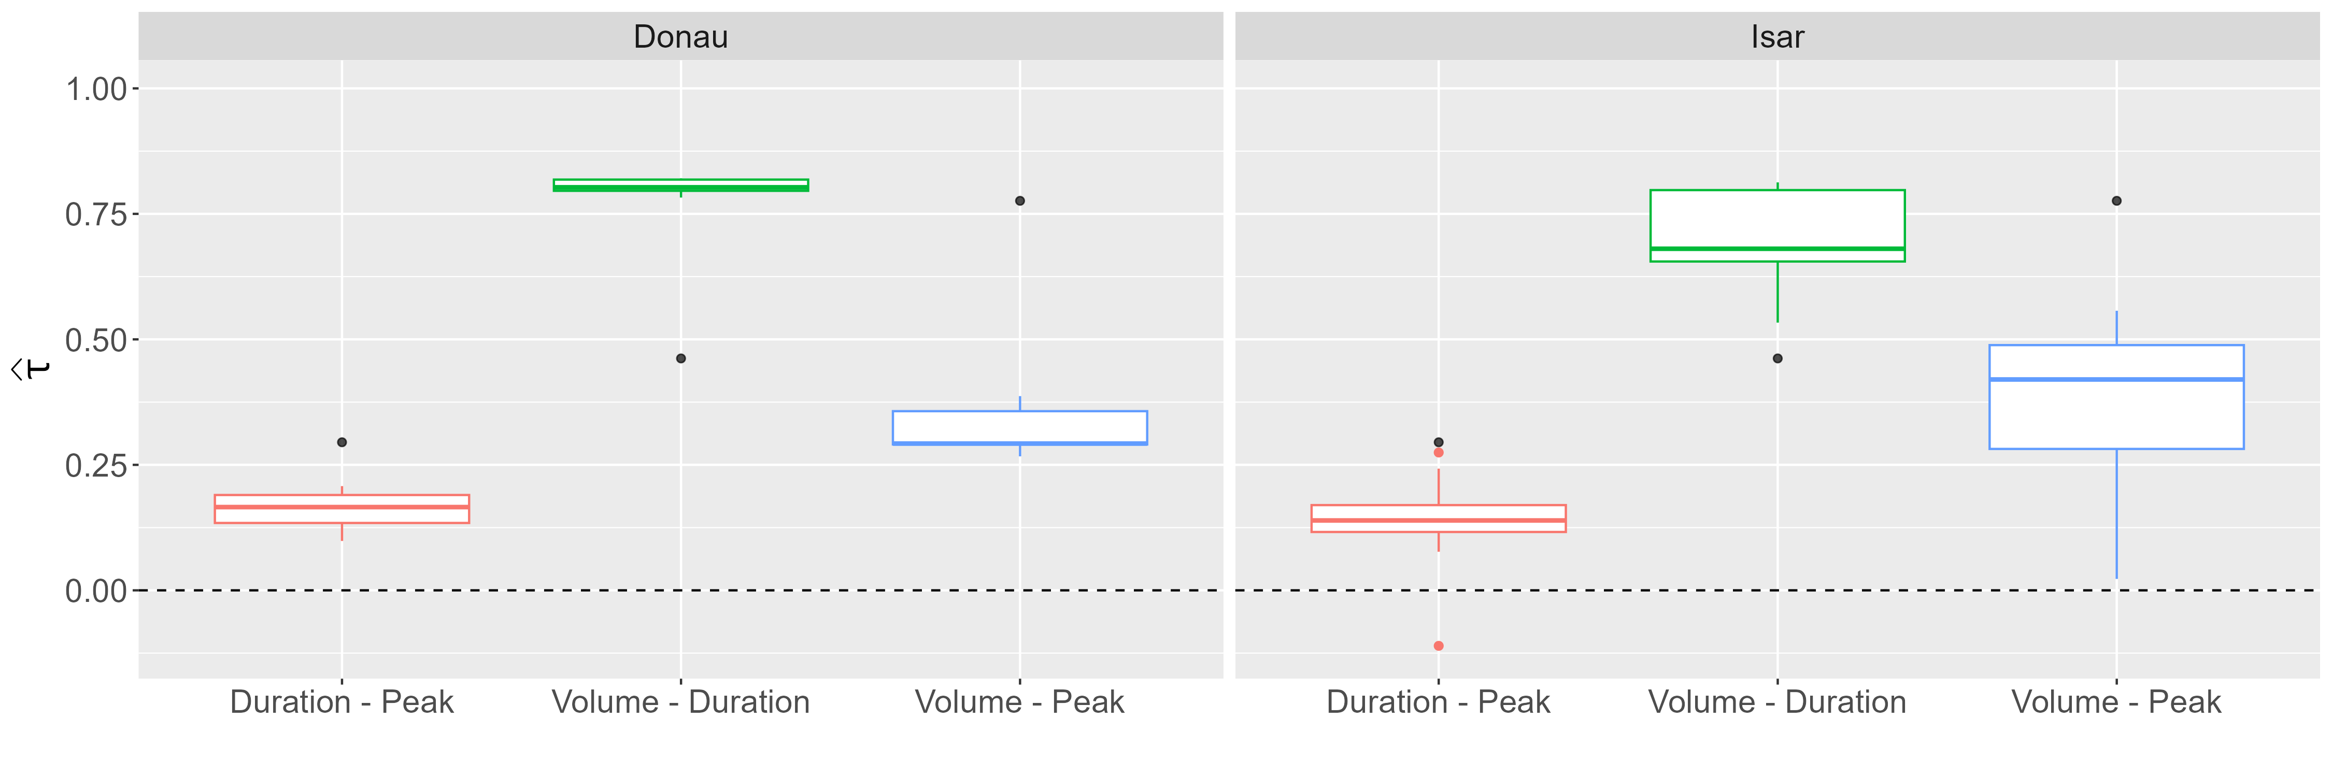
Data – Correlation
Notes:
Boxplots:
Distribution for all Kendall Correlation Coefficients
Tau higher variation in Isar, one correlation even below 0 (Mittenwald)
Important to note: There seem to be three distinct correlation values / three distrinct strength of dependence (Like already seen for Munich station)
Volume-Duration largest by far, then Volume-Peak, then Duration-Peak. This holds for both rivers
The Black Dots the taus observed in the paper. And as seen in the paper, the degree of dependence between these variables depends on the threshold of when a flood is considered as such
Different to the paper: We choose quantiles to define a flood, paper used fixed value
For large threshold, Peak-Volume dependence INCREASES while (paper p 1162) while for others
That is, the behavior we saw for the Munich station does also hold for the other stations
This is VERY important because it implies the violation of NACs
Here critizing the paper:
The paper applies NACs without every showing scatterplots or the correlation among the variables. When comparing our analysis to their, we missed those
Thus, we are uncertain if NACs were applicable to the data in the paper?
In our simulation study we will see what happens if NAC applied to vine DGP
>> This brings us to methods part ☺

Slide 10
Methods
Archimedean Copula
Nested Archimedean Copulae
Vine Copulae
Notes:
We apply copulas
Quick reminder:
Copulas: joint cdf, uniform margins
Decouple dependence strucutre and margins
PIT transformation used (Interim)
Multiple weels to tweak:
Symmetry in a copula
Here: Focus on Archimedean copula → exchangeable (More on that during generators)
Speaking of generators:
Generators define copula family (Next slide)
Arrangement of building blocks
Different Nesting / Conditioning Structure give different Copula
We consider three type of trivariate copulas
Goal here: Copulas are math heavy
Usually you will see „Sklar‘s Theorem“ on which copulas are based on
Goal here: Keep low in math
Thus: Start with the building blox and of bivariate copula and go deeper into the aforementioned propertie

Slide 11
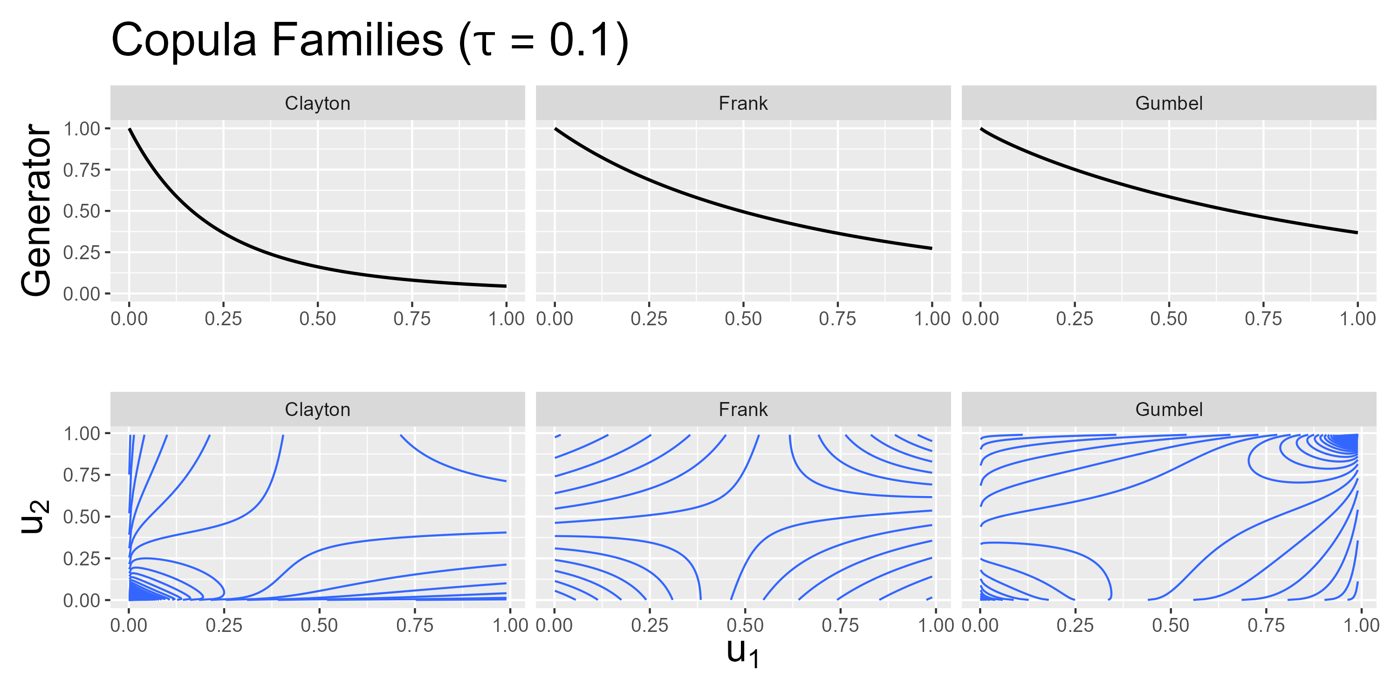
Methods - Generators
Notes:
What are Archimedean copulas? What is exchangeability? And what is a copula family?
Before diving into these questions:
Consider the axes of the plots. They reach from 0 to 1.
This is because, before applying copulas, we transform our data using PIT
Everything that follows is applied to this transformed data
Now, what are Archimedean copulas:
Copulas defined by a generator function
Focus: Clayton, Frank and Gumbel
You can see their generators on the top row
Imagine generator functions as building blocks of an archimedean copula
Plug variables into nesting of generator → gives you the final copula
Generator functions considered depend on one parameter
Parameter of generator connected to correlation → See next slide
Estimating copula = estimating this parameter
What are are Archimedean copula families
Different generators
Depending on generato, contour plot on bottom change
What is exchangeability:
In contour plots, imagine a line from bottom left to top right
This is the axis for which the contour plots are symmetric
This implies that the order in which the variables are plugged into the copula do not matter (More on that when considering AC)
Learning now that generators exist, we can further talk about copula families
Gumbel, Clayton, Frank
Each family defined by is generators
Generator depends on one paramter bzw. on tau
> Estimating this parameter / tau and asuming a copula family gives full BIVARIATE dependence structure
> Plot each and discuss properties / tail dependence
!! Add 1-u and survival copula into appendix!
! Explicitly mention the x –axes in both plots

Slide 12
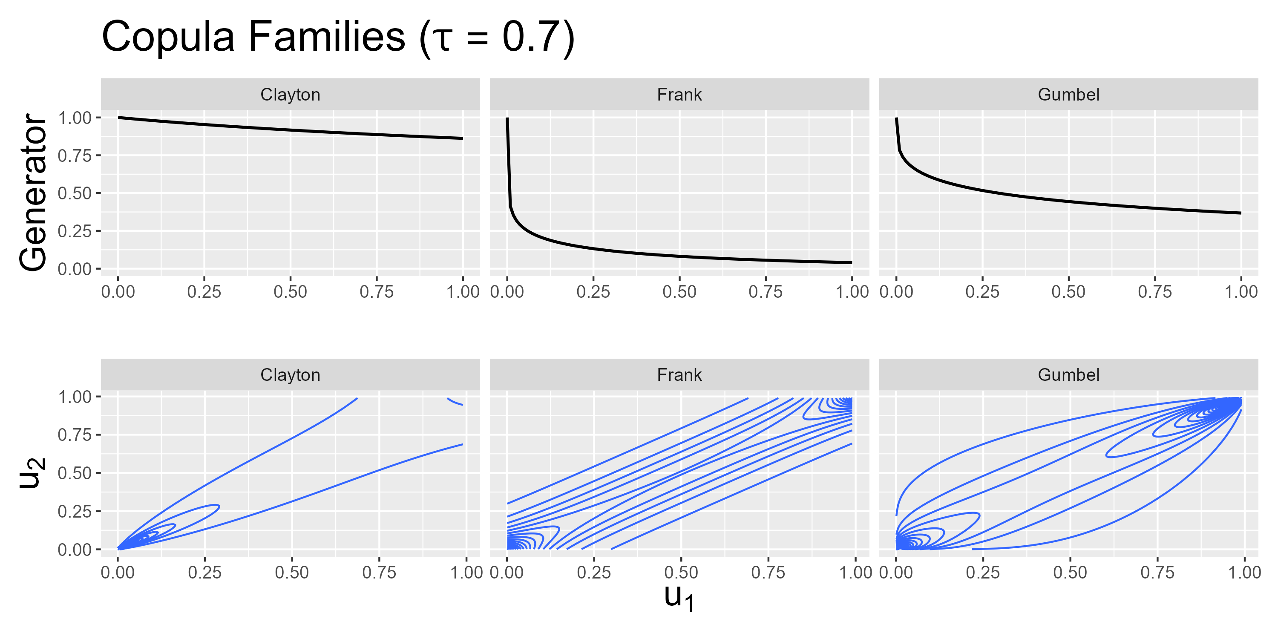
Methods - Generators
Notes:
Strength of correlation from 0.1 → 0.7
Family specific changes in generator
Density Contour plots change accordingly
Now, difference between copula families more clear, especially for extreme values
In this context: General tail dependence
How likely is joint extreme behavior
Mathematically: Limit of probabily → between 0 and 1
Clayton (left): Lower TP: For small u_1, u_2 also small; not the case for large values
Gumbel (right): Upper, but no lower taildependence
Frank (center): No taildependence
So we established what we can tweak in a bivariate case
Multivariate: Arrangement of building blocks matter

Slide 13

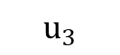
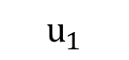
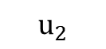
Methods - ACs
$$C\left(u_{1},u_{2},u_{3}\right)=φ^{[−1]}(φ\left(u_{1}\right)+ φ\left(u_{2}\right)+ φ\left(u_{3}\right))$$
$$C$$
$$u_{1}$$
$$u_{2}$$
$$u_{3}$$
Notes:
Upfront: 3 variables = 3 way to combine them = 3 possible dependence structures
Simplest Case: trivariate AC
3 things to notice:
On top: This is how generator phi used build Archimedean copula
#Generators / #Copulas you see in tree
Corresponds to #Possibly Unique Dependence Structures
Here: One C → AC implies same dependence for all
In other words:
Exchangeability: Order Us does not change C
Implied limitation:
Variables of family AND strength of dependence
(Also strength, bc one generator function is used and the parameter of generator depends on strength of dependence)
Reference to data: Fitting a simple AC implies assumption that correlation between peak, volume and duration is identical

Slide 14

Methods - NACs
$$C\left(u_{1},u_{2},u_{3}\right)=C_{1}\left({u_{1},C}_{2}\left(u_{2},u_{3}\right)\right)$$
$$C_{1}$$
$$u_{1}$$
$$C_{2}$$
$$u_{2}$$
$$u_{3}$$
Notes:
Next step:
Nest ACs → NACs
Trivariate: Nest 2 bivariate copulas (see tree)
Applying #copulas = #Unique Dependence:
For THREE variables, we can only display TWO unique dependence structure
Limitation here:
Partically exchangeability: Order in which we plug u2 and u3 in does not matter
→ Applying NACs implies assumption: two dependence structures in data are same
Data reference: Still not sufficient AND Also not sufficient for paper
Thus: Extend paper approach by VINE copulas

Slide 15
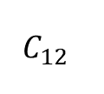
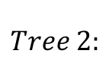
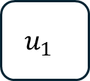
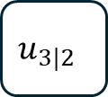
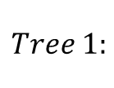
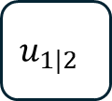
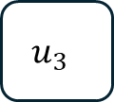
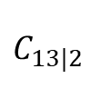
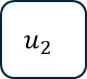
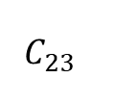
Methods – Simplified Vines
$$c\left(u_{1},u_{2},u_{3}\right)=c_{12}\left(u_{1},u_{2}\right)c_{23}\left(u_{2},u_{3}\right)c_{13|2}\left(u_{1}\left|u_{2},u_{3}\right|u_{2}\right)$$
$$C_{12}$$
$$C_{23}$$
$$Tree 1:$$
$$u_{1}$$
$$u_{2}$$
$$u_{3}$$
$$C_{13|2}$$
$$Tree 2:$$
$$u_{1|2}$$
$$u_{3|2}$$
Czado 2019.
Notes:
Finally: Vines
Note, the above function now is the copula density
Sidenote: Copula obtained by integration
Vines
3 bivariate copulas with one being a conditional copula
Tree 1: 2 unconditional Copulas (above line)
Tree 2: 1 conditional Copula (above line)
#Cops = #Unique Dependence
3 unique structures → NO limitation for dependence strcutre → Well suited for our case bc correlation boxplots
Takeaways / Expectation:
Data: 3 different strength of dependence
Expectation: Acs and NACs infeasible, Vines good fit

Slide 16
Simulation – Setup
Parameter | Value
 | NAC DGP | Vine DGP
Sample size | 15, 30, 50, 1000
Correlation* | Donau: (0.18, 0.32, 0.81) Isar: (0.13, 0.38, 0.69) Low-High-High: (0.10, 0.80, 0.80) Low-Med.-High: (0.10, 0.50, 0.85)
Iterations per setup | 4000 | 27000
Copula Families | Gumbel, Clayton, Frank | G-G-G, G-G-C, G-G-F, …
*Correlation structure for NACs obtained by building average over the two larger correlation values
Notes:
Validate expectation and paper reproduction:
Ran simulation:
Reproduction:
Paper found AC bad performance if NAC true
Established bias of AC estimate if NAC true
Expectation validationn
Examine NACs if Vine true
Examine Vines if NAC true (misspecification)
Examine Vine performance if Vine true
Paper extension:
Establish bias of NAC estimate if Vine true
Settings:
Setting 1: NAC DGP
Setting 2: Vine DGP
For each setting:
Varying sample sizes:
#Observations copula estimation is based on
Sample sizes:
50: Common in our data set
15 and 30: Performance for low sample size
1000: Large sample performance
Varying correlation structures:
Isar, Donau: Average correlation of rivers over stations
LowHighHigh: One low, two similar and high correlation values
LowMedHigh: One low, one medium and one large correlation value
Reason: Found bias in NAC dependending on smallest 2 correlation
Also: No negative correlation, because barely relevant (one outlier)
(((Also: negative corr in copula can be turned into positive ones using 1-u)
Varying copula families
NACs: underlying model was allowed only of one trivariate family
Vines: every copula was allowed one of 3 copula families
Leads to the number of iterations :
For NAC, setup = c(n, family) → Fitted each of these combination 4k times
Leads to each c(n, family, correlation) was fitted 1k times
For Vines, setup = c(n, familycombination, correlation) 250 each: There are 3 families and 3 variables → 3^3 = 27 → B = 27 * 1000 / 4
Copula selection within each setup was done using AIC
Note on correlation:
NAC: average large values for inner and keep smallest for outer
Vine: 1-2-3, T2: 1|2-3|2 where 1-2 has largest, then 2-3, then 1-3

Slide 17
Simulation – Results
Reproduction
NAC DGP: NAC > AC and threshold confirmed
Validation
Vine DGP: Vine > NAC
NAC DGP: Vine still good
Extension
Vine DGP: Identified bias

Slide 18
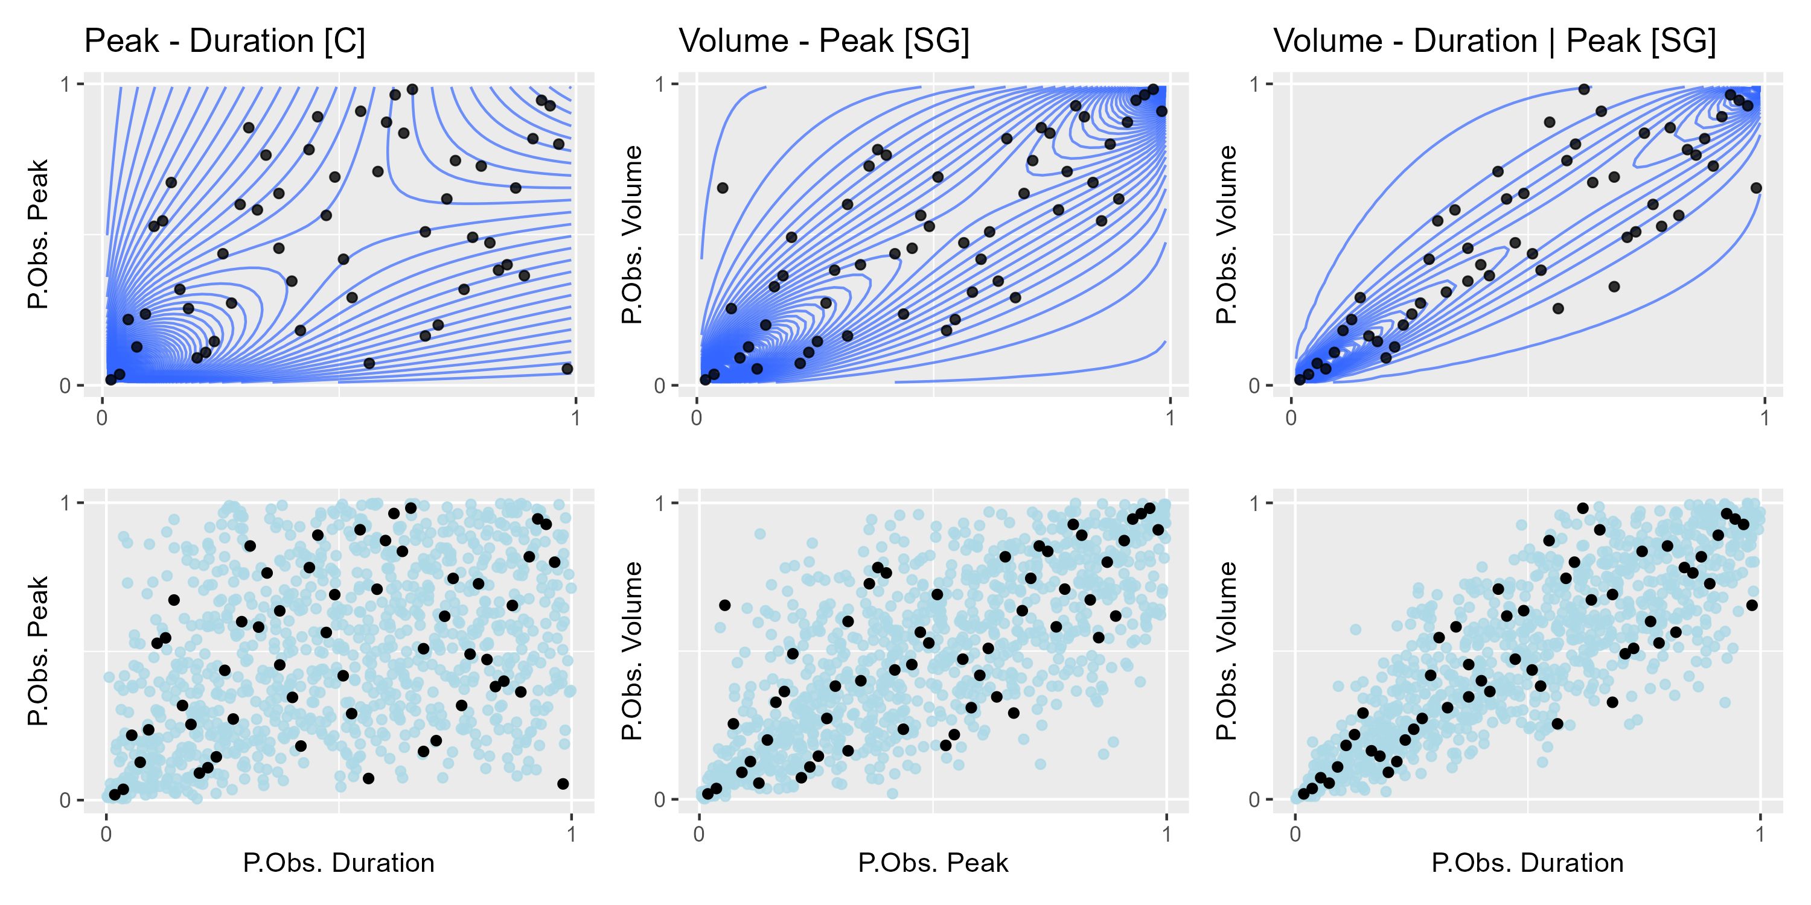
Results – Visual GoF Munich Station
Notes:
Now, we fit multiple vine models and select according to AIC
This is result for Munich station
Top row: Contours of fitted copula density
Center row: Synthetic data generated by fitted copula
Bottom row: Re-transformed synthetic data
Details:
Peak – Duration and Volume – Peak are Gumbel copulas
Volume – Duration is the conditional copula and is Survival Gumbel
The top row gives neat representation of model
First row: Contour,
Bottom is syn data because I like it better to judge fit than contours

Slide 19
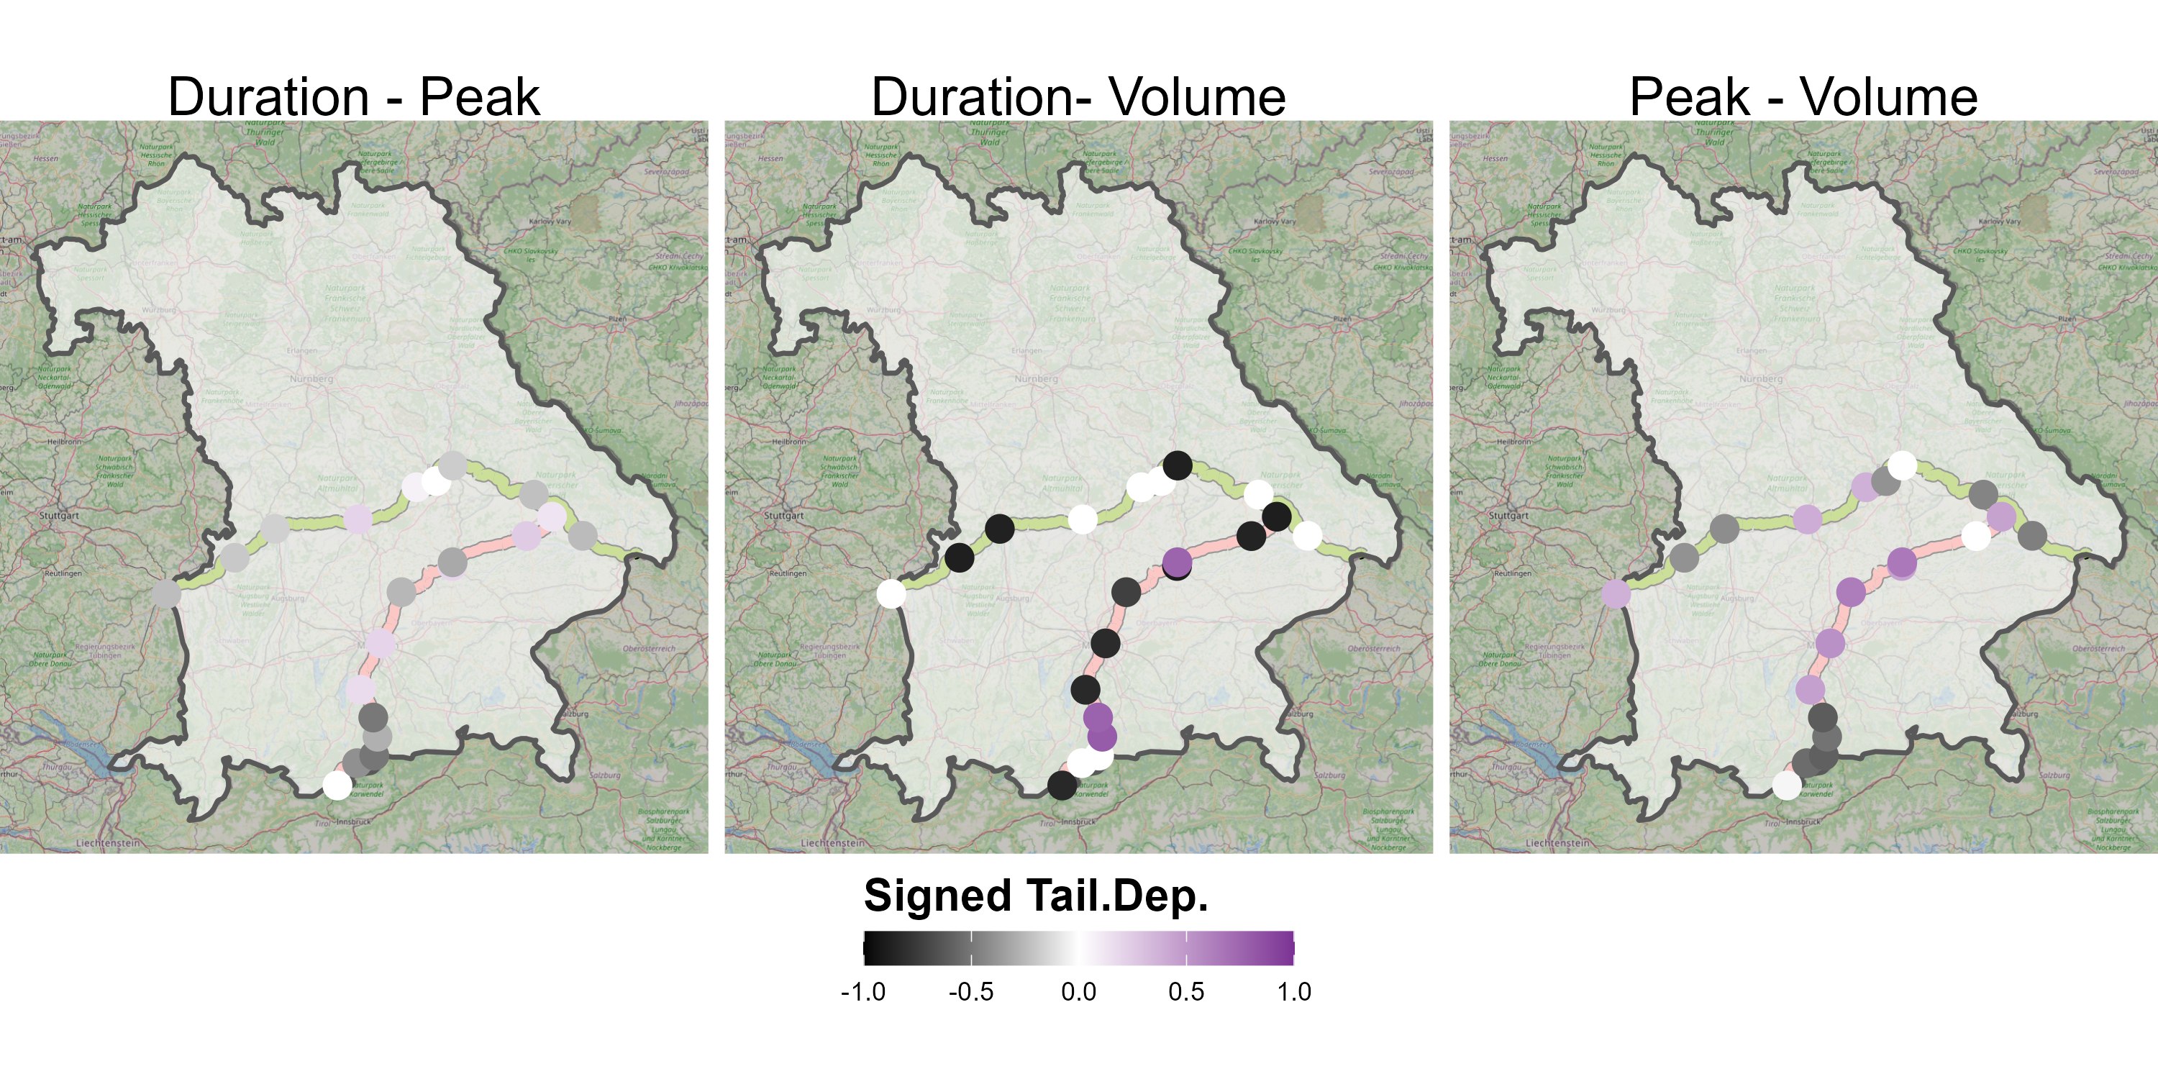
Results - Taildep
Notes:
Stronger taildep in Dur-Vol, smaller in Peak-Vol and least in Dur-Peak
Basicaslly reflect the different correlation strength – which makes sense since tail dep. Is function is parameter – but ALSO shows that majority of extreme events occure jointly in variable values
Would be great to consider additional covariates (see outlook)

Slide 20
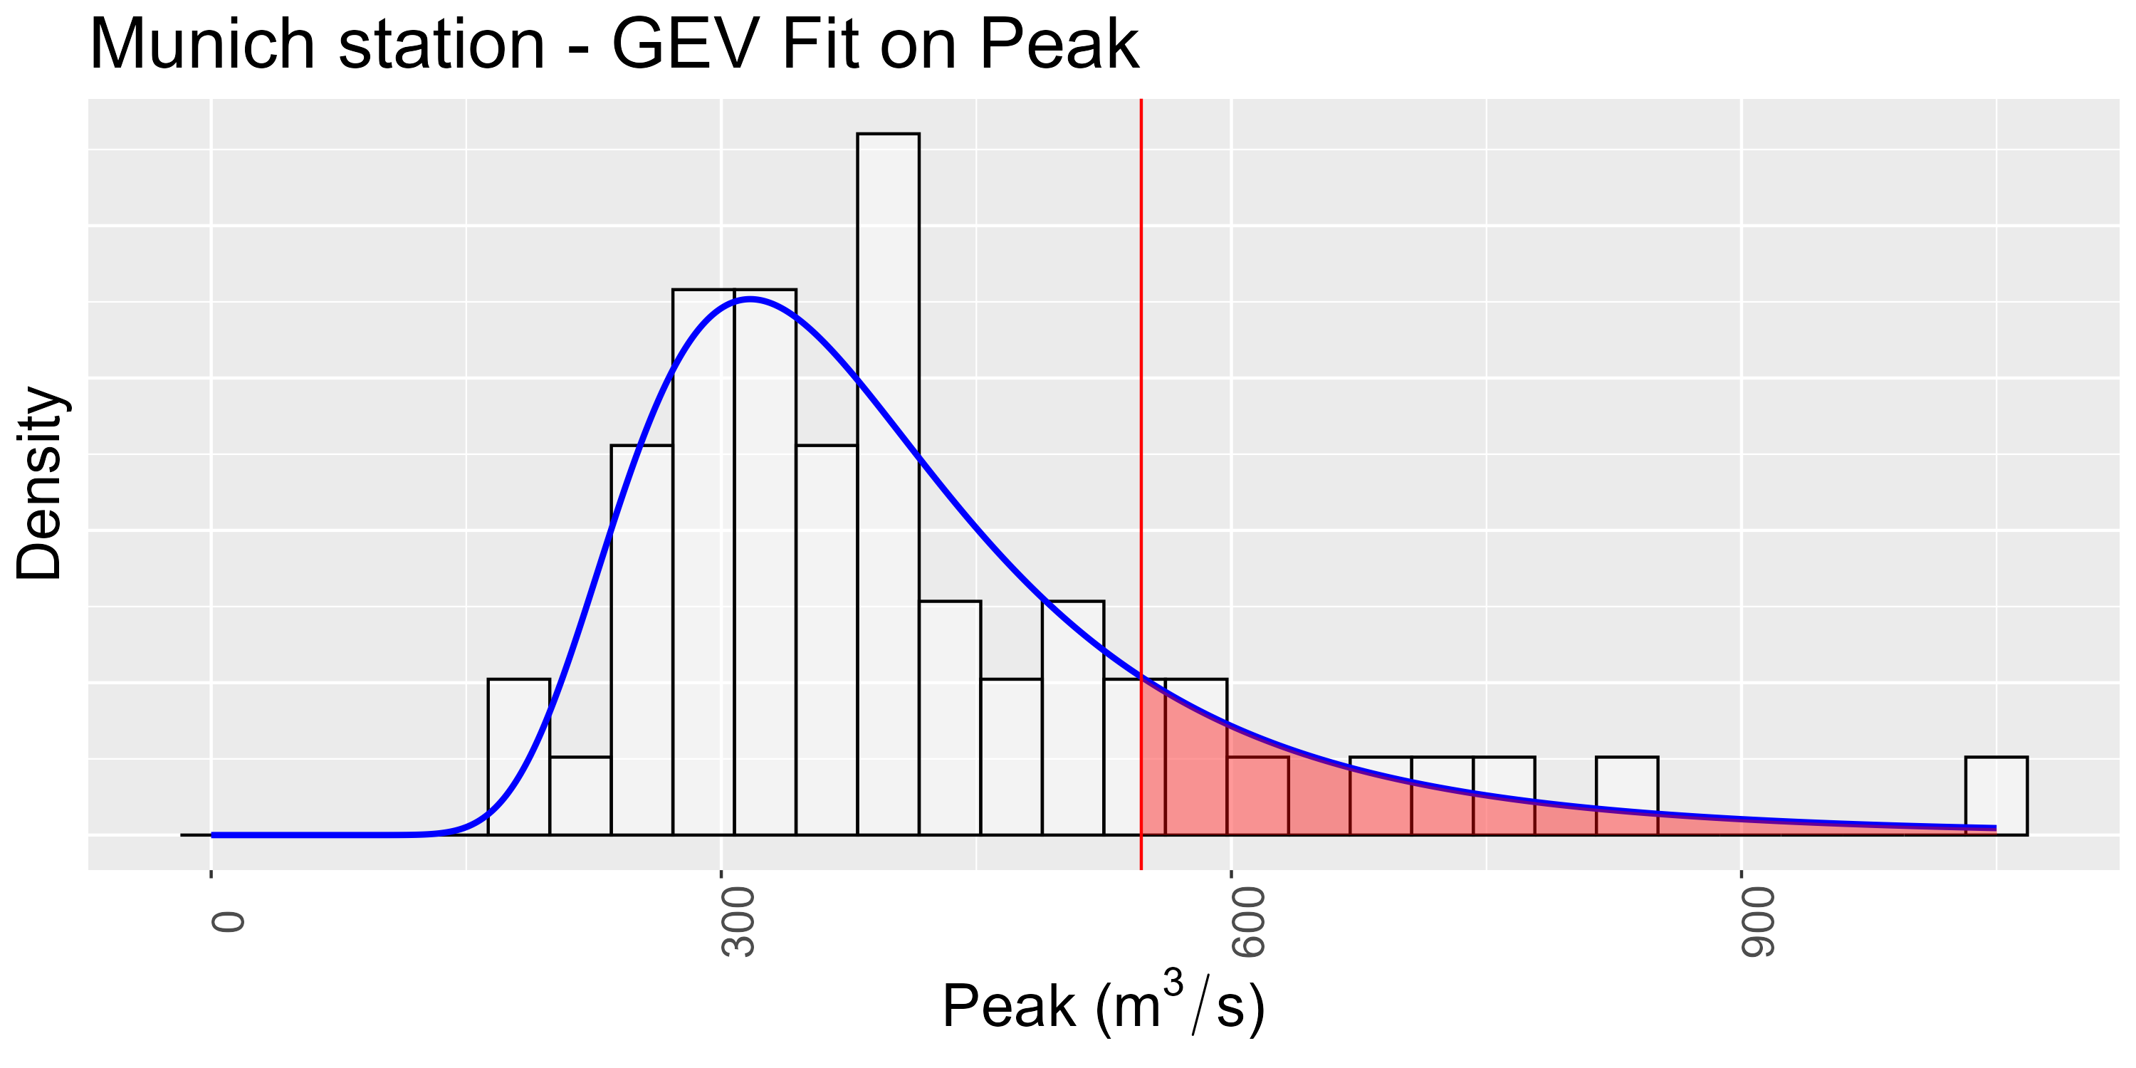
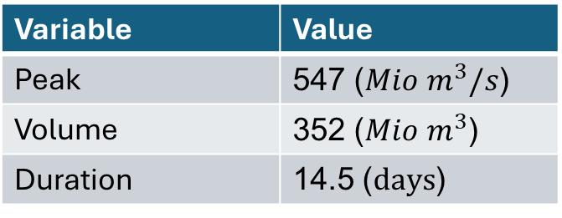
Results – Univariate Return Period
Idea: Estimate return periods using quantiles of fitted distribution
Flood Munich 2024:
Variable | Value
Peak | 547 (${Mio m}^{3}/s$)
Volume | 352 (${Mio m}^{3}$)
Duration | 14.5 ($days$)

Slide 21
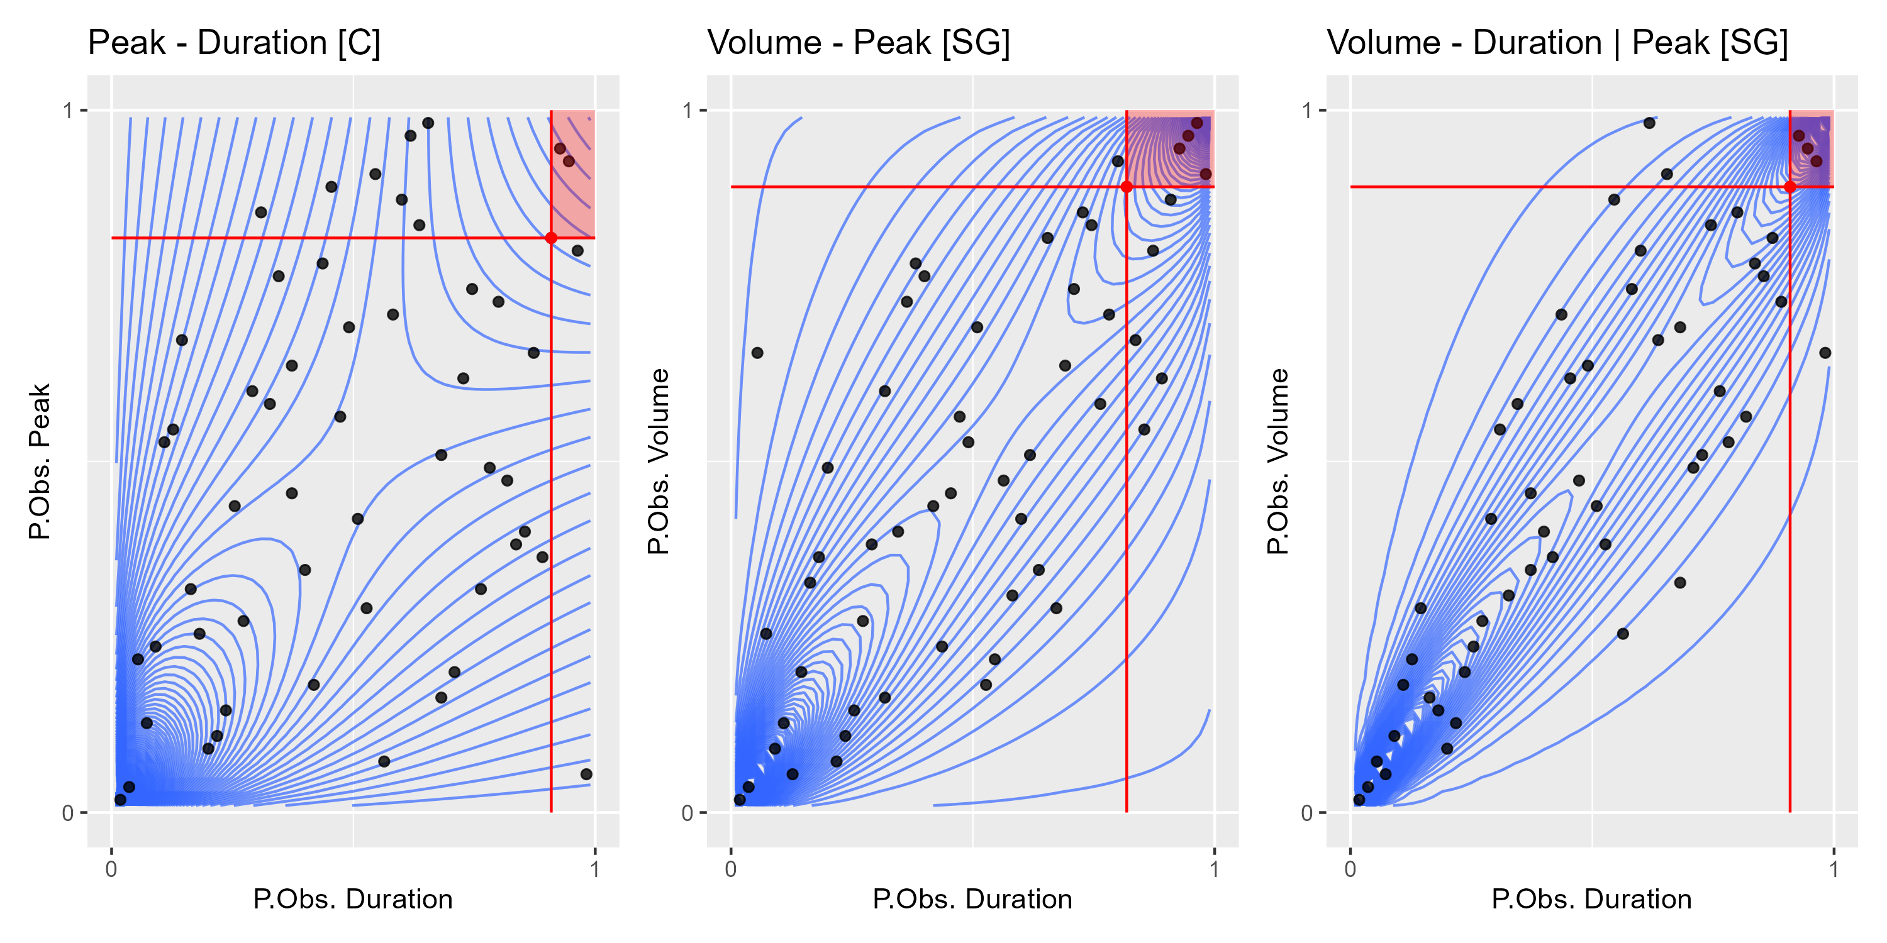
Results – Multivariate Return Period
Notes:
0.1591396 vs 0.03

Slide 22
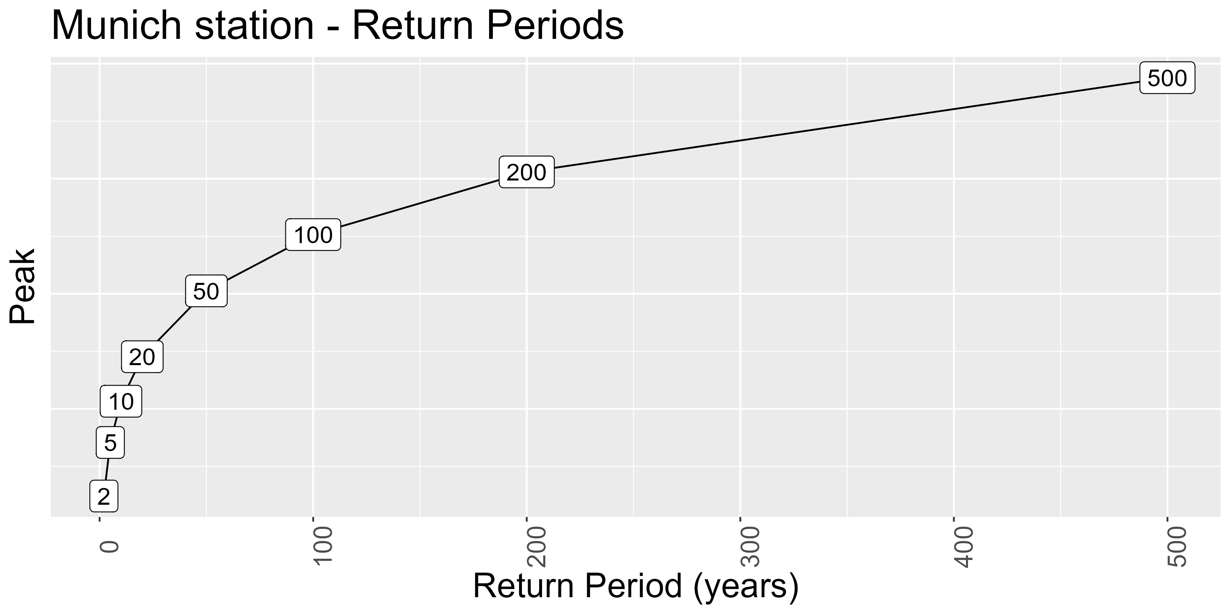
Results – Conditional Distribution

Slide 23
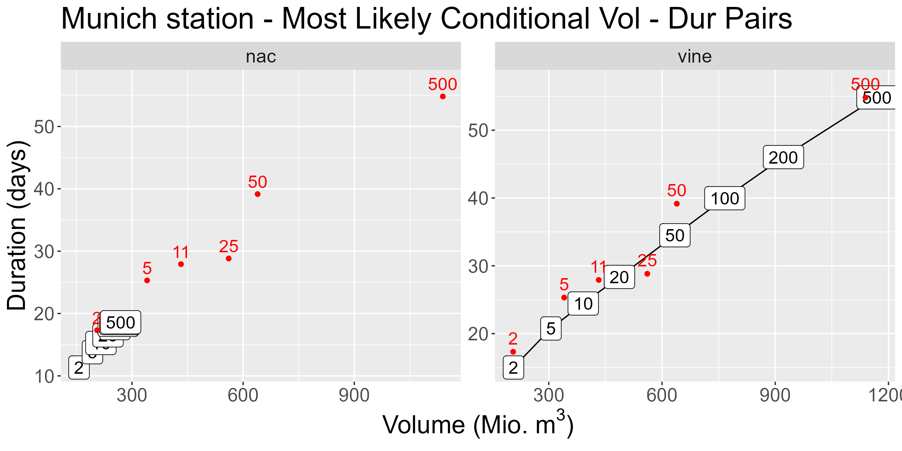
Results – Conditional Distribution

Slide 24
Discussion
gamCopula
Inclusion of covariates
Seasonal copula
Changing flood behavior by season
Threshold choice
The marginal fit

Slide 25
Summary
Simulation
Validated vine performance (Misspecified and non-misspecified)
Reproduced and extended paper
Application
Univariate point of view is incomplete
Taildependence structure requires additional information
Improve marginal fit
Outlook
Include covariates
Seasonal copulas

Slide 26
Sources
Bayerische Staatsregierung (BS, 2025): Pressemitteilungen. URL: https://www.bayern.de/hochwasser-bayern-2024-fueracker-bayern-fordert-versprochene-solidaritaet-des-bundes-ein-angekuendigte-bundesmittel-fuer-hochwasserschaeden-in-bayern-bislang-ausgeblieben-finanzausschuss-des/#:~:text=Nach%20vorl%C3%A4ufiger%20Sch%C3%A4tzung%20belaufen%20sich,2%20Milliarden%20Euro%20versichert%20waren. (as of 03/16/2025).
Czado C. (2019): Analyzing Dependent Data with Vine Copulas A Practical Guide With R. Cham, Switzerland.
Gewässerkundlicher Dienst Bayern (GKD, 2025): Abfluss Bayern. URL: https://www.gkd.bayern.de/de/fluesse/abfluss (as of 03/16/2025).
Grimaldi S., Serinaldi F. (2006): Asymmetric copula in multivariate flood frequency analysis. In: Advances in Water Resources, 29, 1155-1167.
Khajehali M., Sfavi H., Nikoo M., Najafi M., Alizadeh-Sh R. (2025): A copula-based multivariate flood frequency analysis under climate change effects. In: Nature Scientific Reports, 2025, 1-16.

Slide 27
Appendix
Notes:
If true model is NAC, Vines still perform well (Evaluated this using KLD)
Reason: Vines more flex than NAC
Reproduced paper results if true is NAC and AC applied + extended this for smaller samples
i.e. AC tau underestimates true dependence structure
If true model is vines, NACs perform worse depending on the correlation values of vines
Reason: NACs systematically overestimate the correlation strength
That is: Outer tau is closer to 2nd largest vine tau
LOLOLOL Slide is shit. Fix after checking if we use plots or not

Slide 28
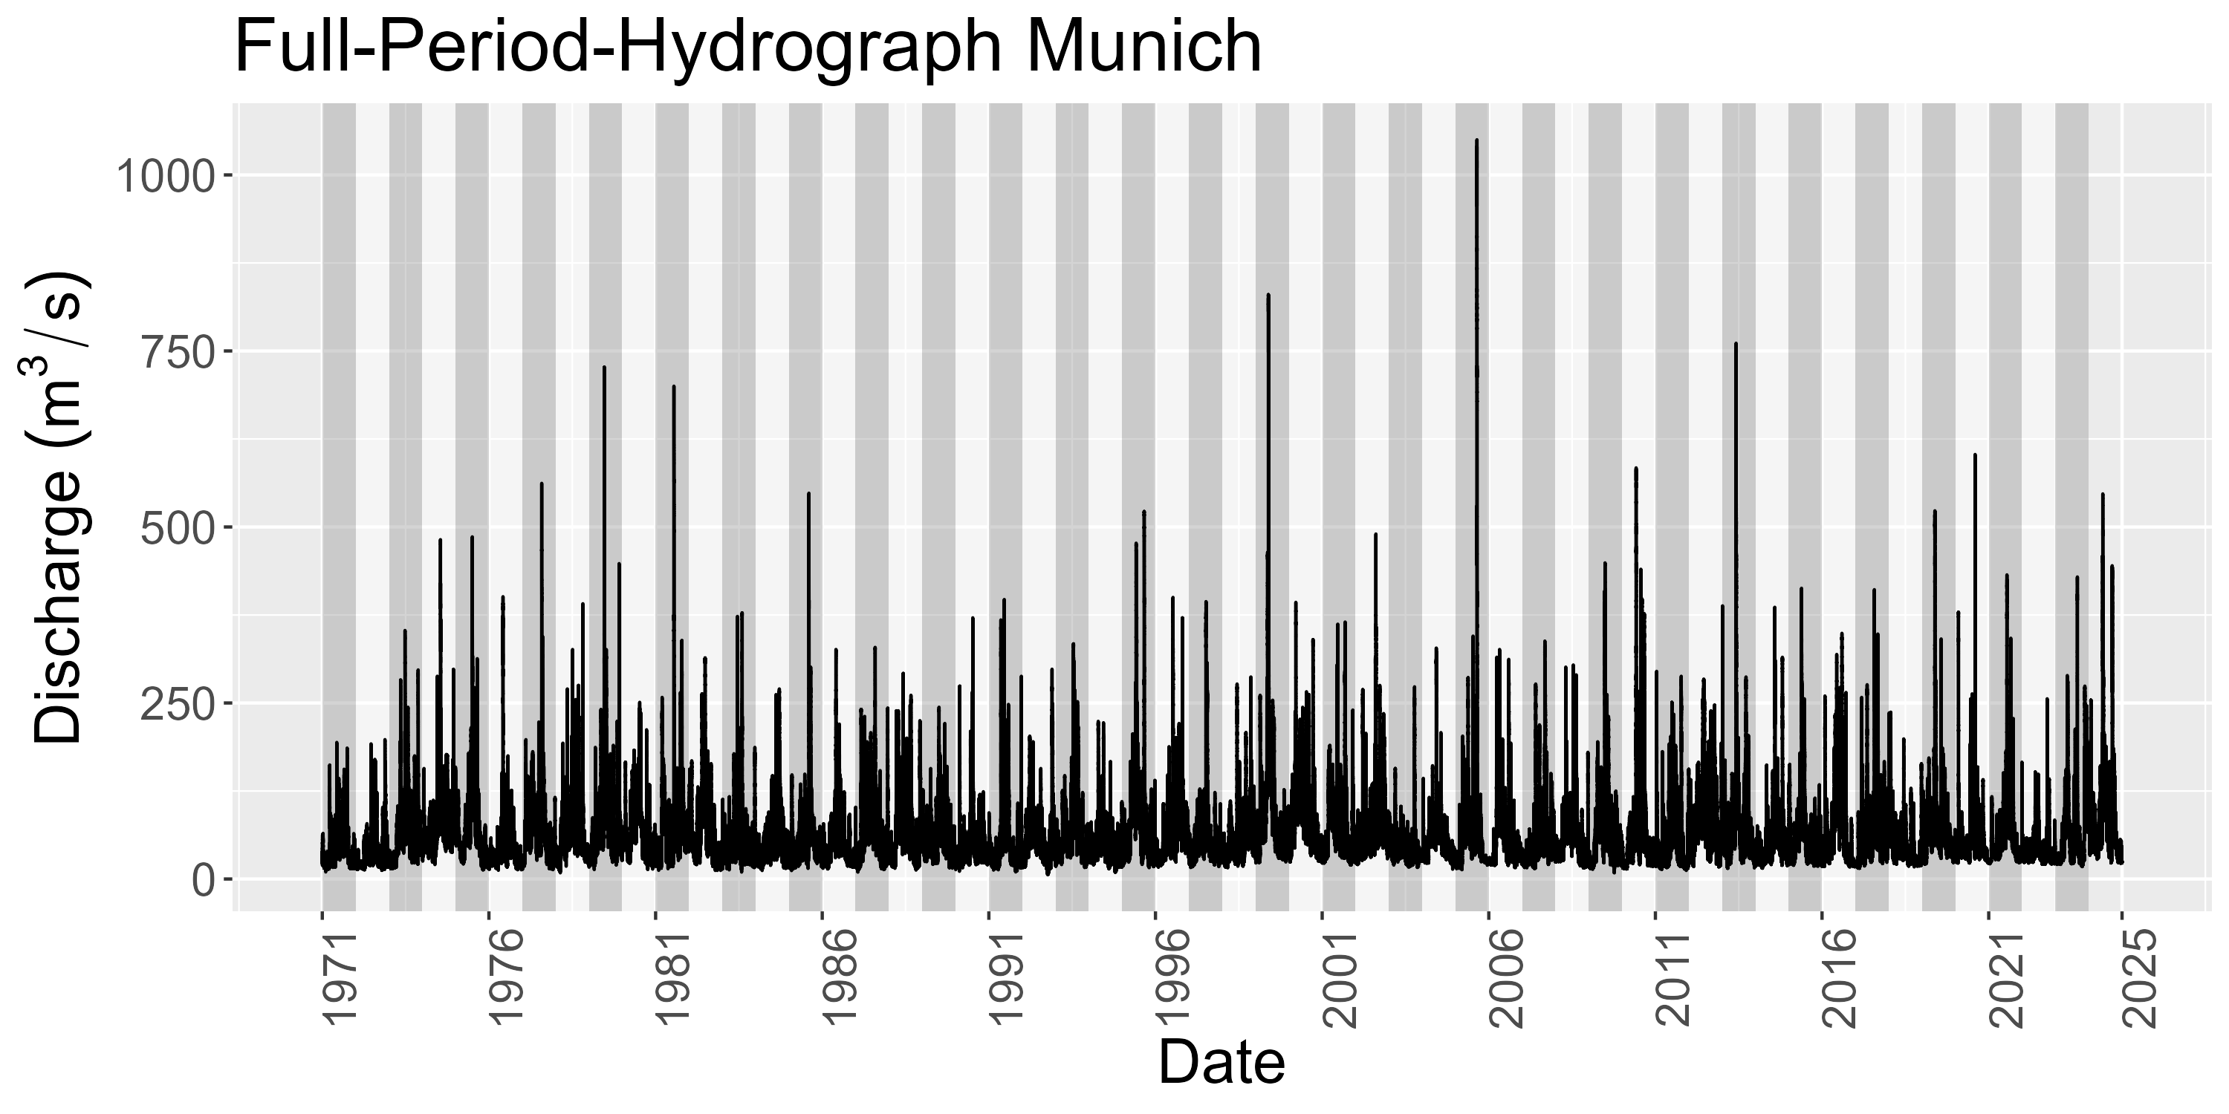
Data – Munich Station
Notes:
Hydrograph over 54 years
See later: number of years are number of observations per station

Slide 29
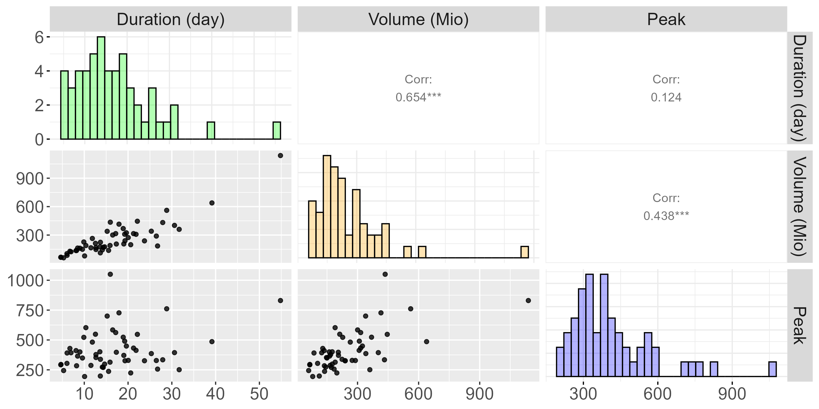
Data – Munich Station
Notes:
Do that for every year to obtain nobs = #years observations
This data used to fit station specific copula

Slide 30
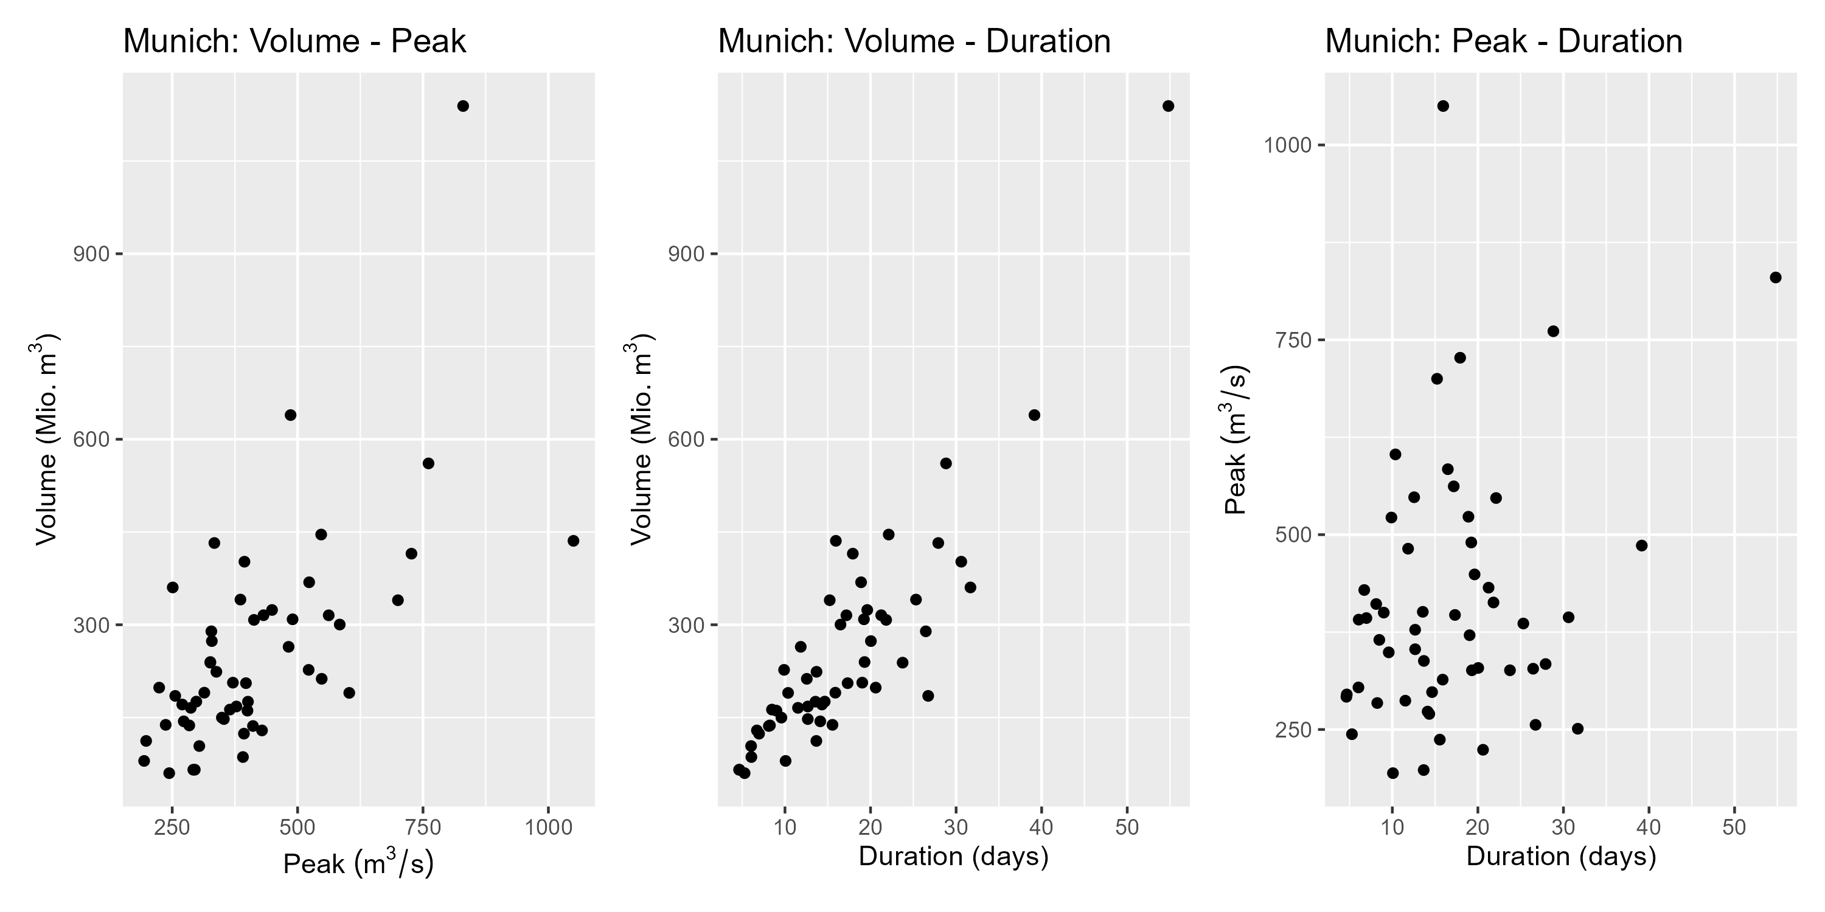
Appendix

Slide 31
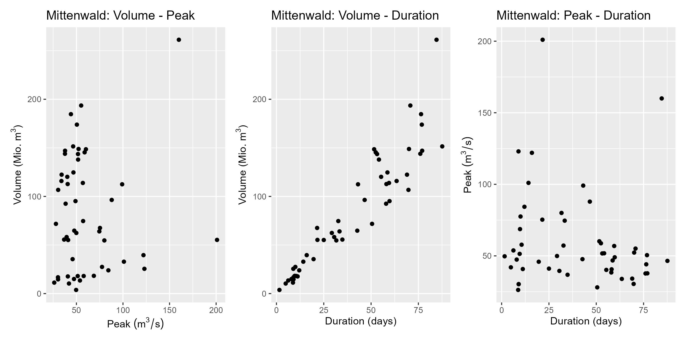
Appendix
Notes:
Negative correlation for duration-peak

Slide 32
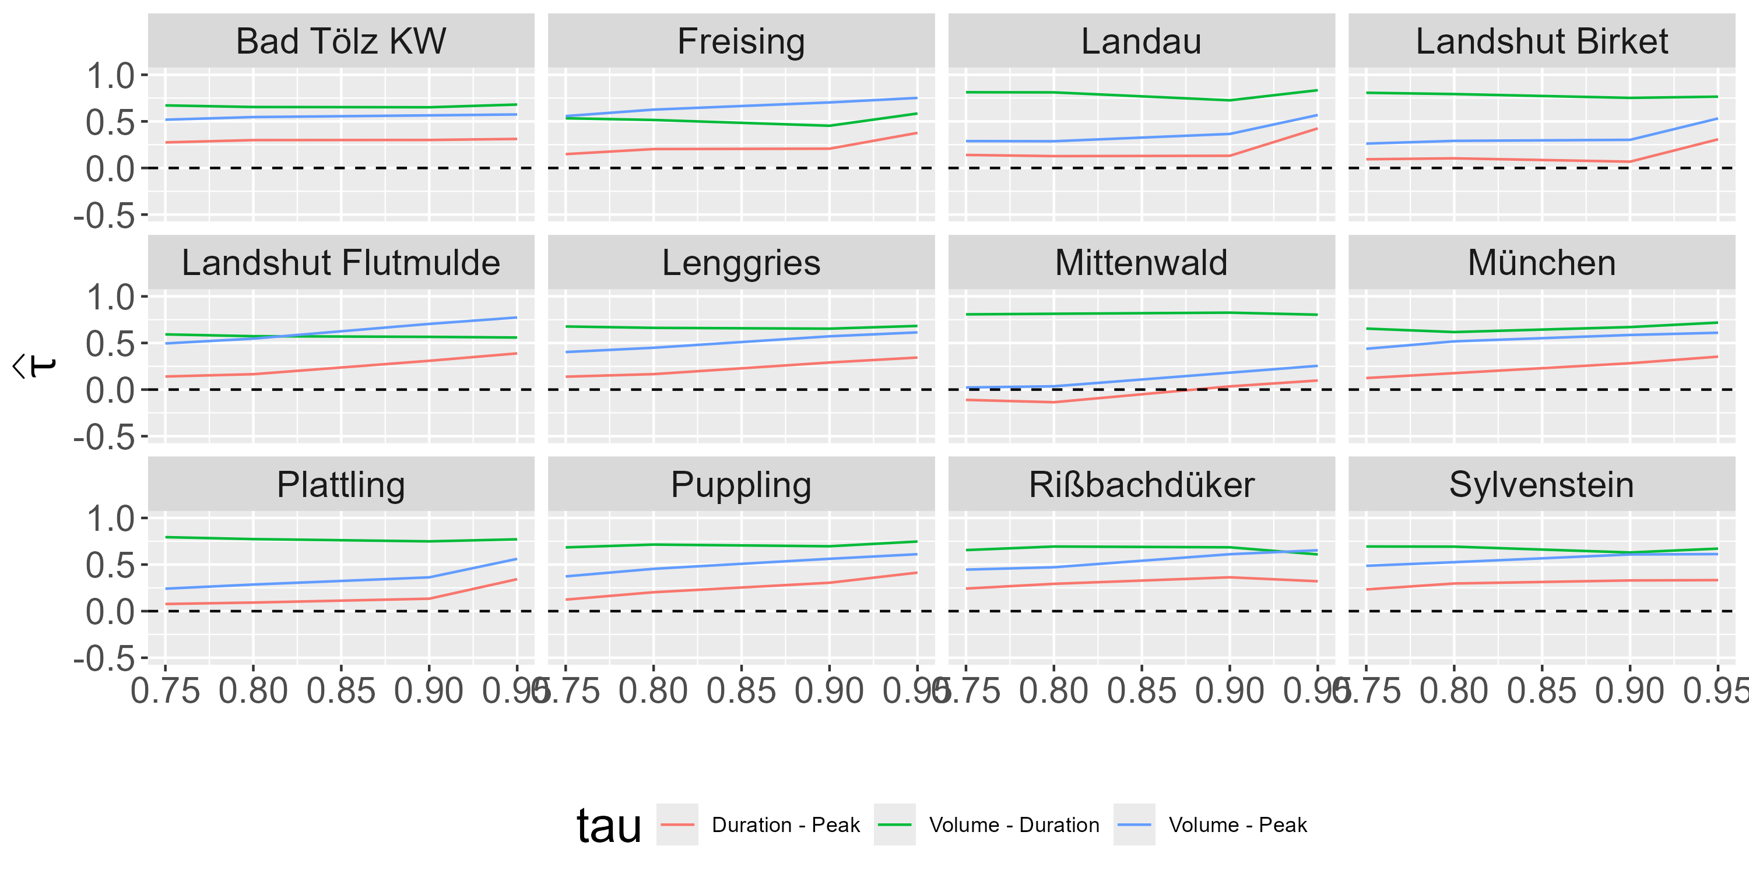
Appendix – Isar – Corr. by Threshold
Notes:
Negative correlation for duration-peak

Slide 33
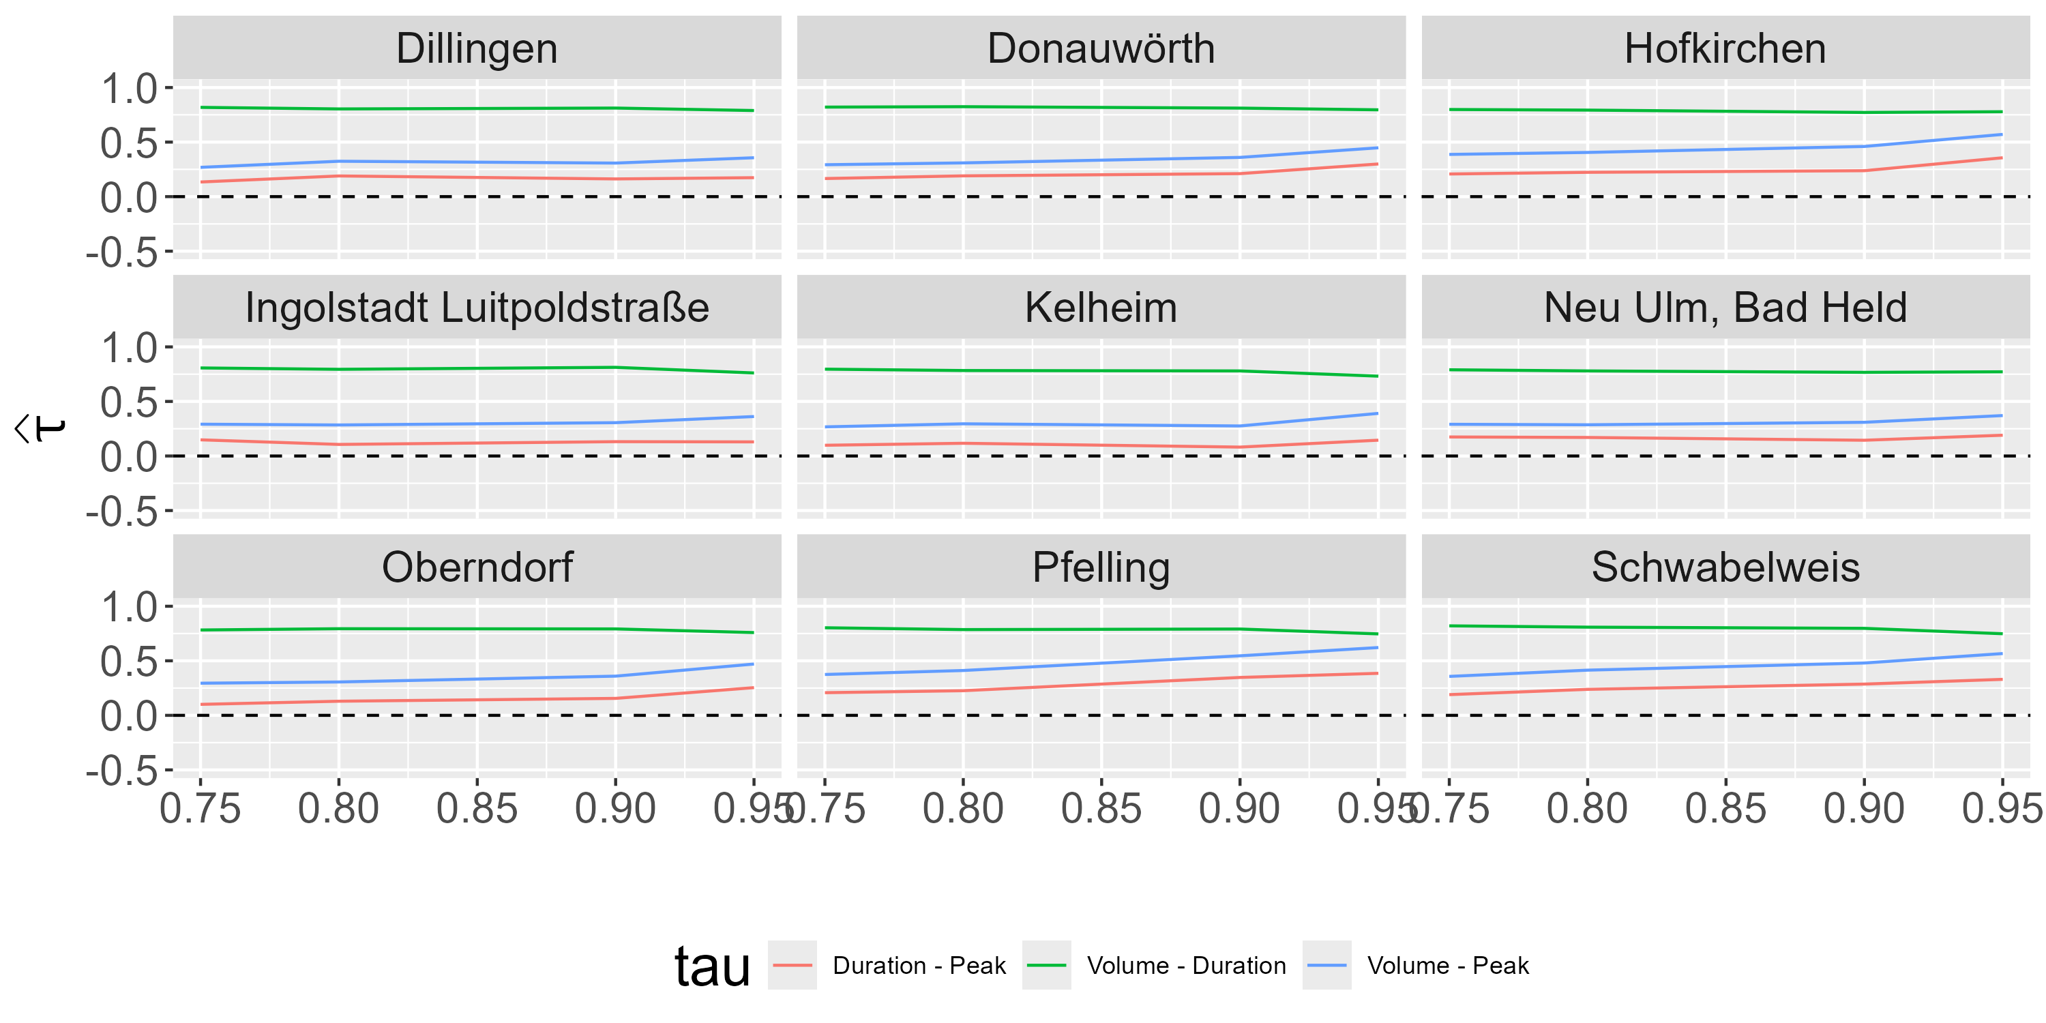
Appendix – Donau – Corr. by Threshold
Notes:
Negative correlation for duration-peak

Slide 34
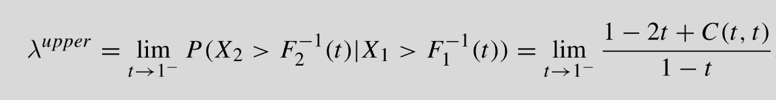
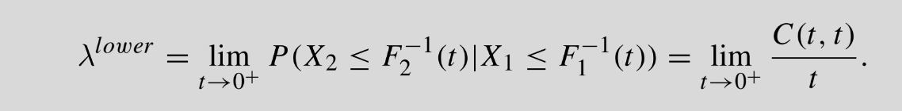
Appendix – Tail Dependence
Notes:
Sorry for this slide… It‘s just a backup and putting this into PPP is a pain
Czado p. 34

Slide 35
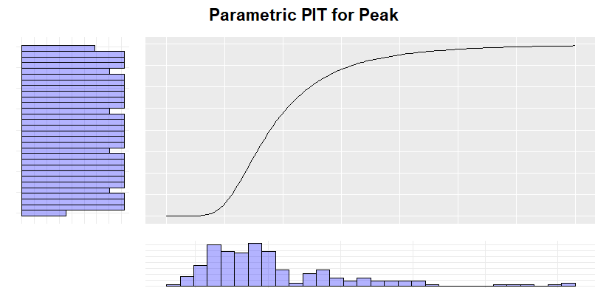
Appendix - PIT
Notes:
Concept of PIT:
We used empirical CDF
> Then, CDF is step function and not smooth
> The transformed variables are „psuedo obs“

Slide 36
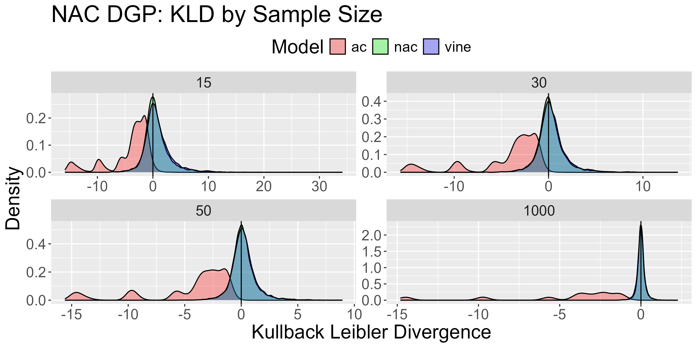
Simulation – NAC DGP
Notes:
Describe plots:
For each of run, we proxied KLD (MonteCarlo Method)
You see this proxi separated by sample size
Optimal: KLD of 0 → Density with high peak at 0 and small variance desirable
Systematic deviation from 0 shows bias
High variance shows low precision / high variance in model fit
We see:
Green / NAC and Blue / Vines pretty much look identical for every sample size:
Both close around 0 with similar variance
For increasing sample size, the underlying dependence structure is pretty well proximated
AC looks really bad: Not centered around 0 with large variance
Performance explained:
AC due to restriction
NAC are true and expected to performe well
Vines are more flexible than NACs → They can capture this partial symmetry
Important Takeaway:
Even if underlying structure is NAC, Vines performe quite well
Reason I mention this:
In our analysis, we will focus only on the fitted vines
This is not only due to the evidence of NACs not being suitable, but also because, as we see here, vines are perfectly fine even if NACs were true

Slide 37
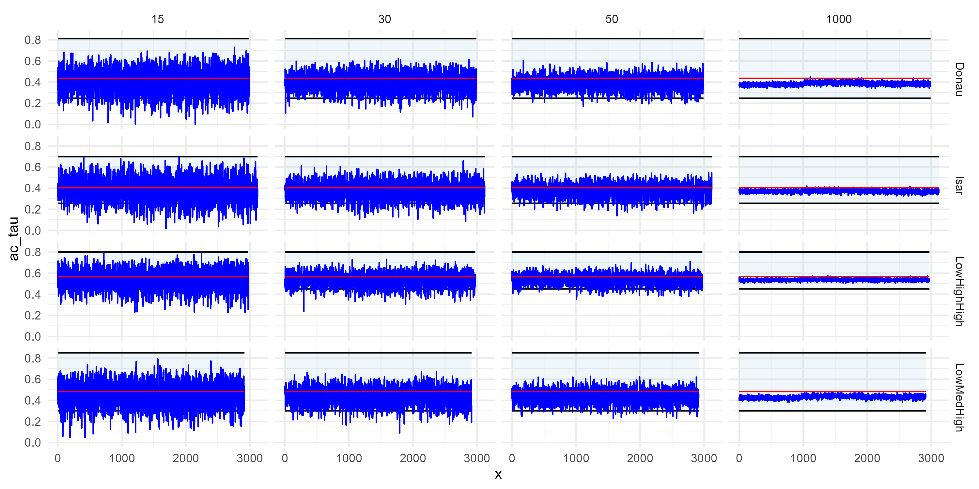
Simulation – NAC DGP
Notes:
Reproduce paper result
For n = 5k, tau estimated by AC is not larger than ~1/3 of area
→ We did not run 5k sims, but
A) We can confirm behavior for around 1k
B) For smaller n, we cannot confirm this limit, but a clear bias towards the lower correlation value
Takeaway:
If AC applied to NAC, we systematically underestimate dependence structures
Discussing this bc
A) To confirm paper
B) Questions arisis what happens if NACs are applied to Vine DGP
i.e. What bias does the paper have due to applying NAC to something that does not look like it suffices NAC assumption

Slide 38
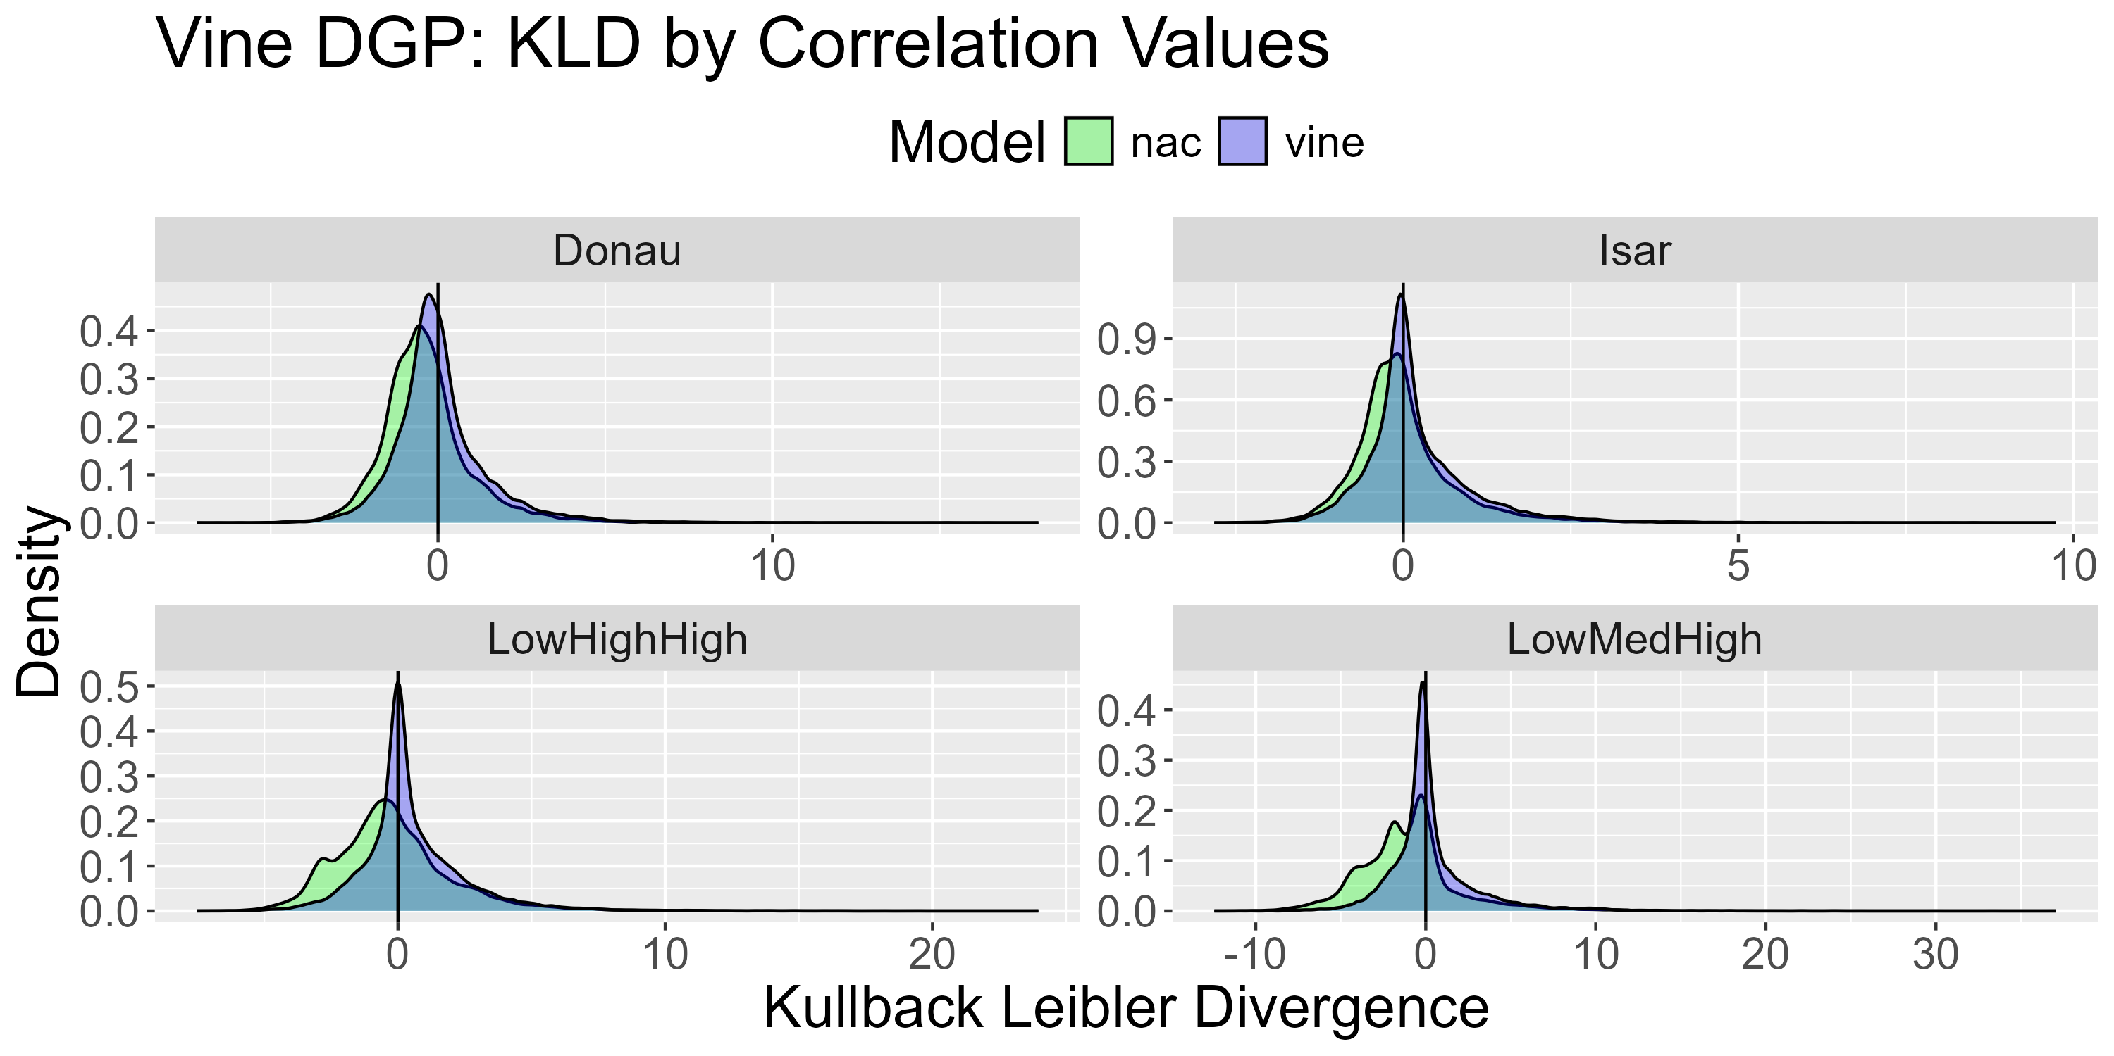
Simulation – Vine DGP
Notes:
For Vines, we again consider KLD
BUT: Instead of by n, consider by correlation structure
Reason: By n hints to large sample behavior and we would see that NAC do not perform as great as vines for large n
(in case interest, we can look at that plot later, ist in appendix)
Instead: Directly look at reason why NACs do not perform well for large n:
NACs performe remarkably worse than vines now that we have 3 different correlation values
And more interestingly:
The more different these correlation values are, the worse the bias.
Obvious reaosn: NACs can only capture two different correlation strength, if we have 3, it just cannot capture that it
That being, if we have 3, but 2 of them are very similar, then NACs seem to work fine as there is not a sever issue when modelling two barely different structures as one
Intersting now:
Same as for AC, in what direction is the bias of NACs?
Bzw. What happens to the 3rd dependence structure when only 2 are available in NAC

Slide 39
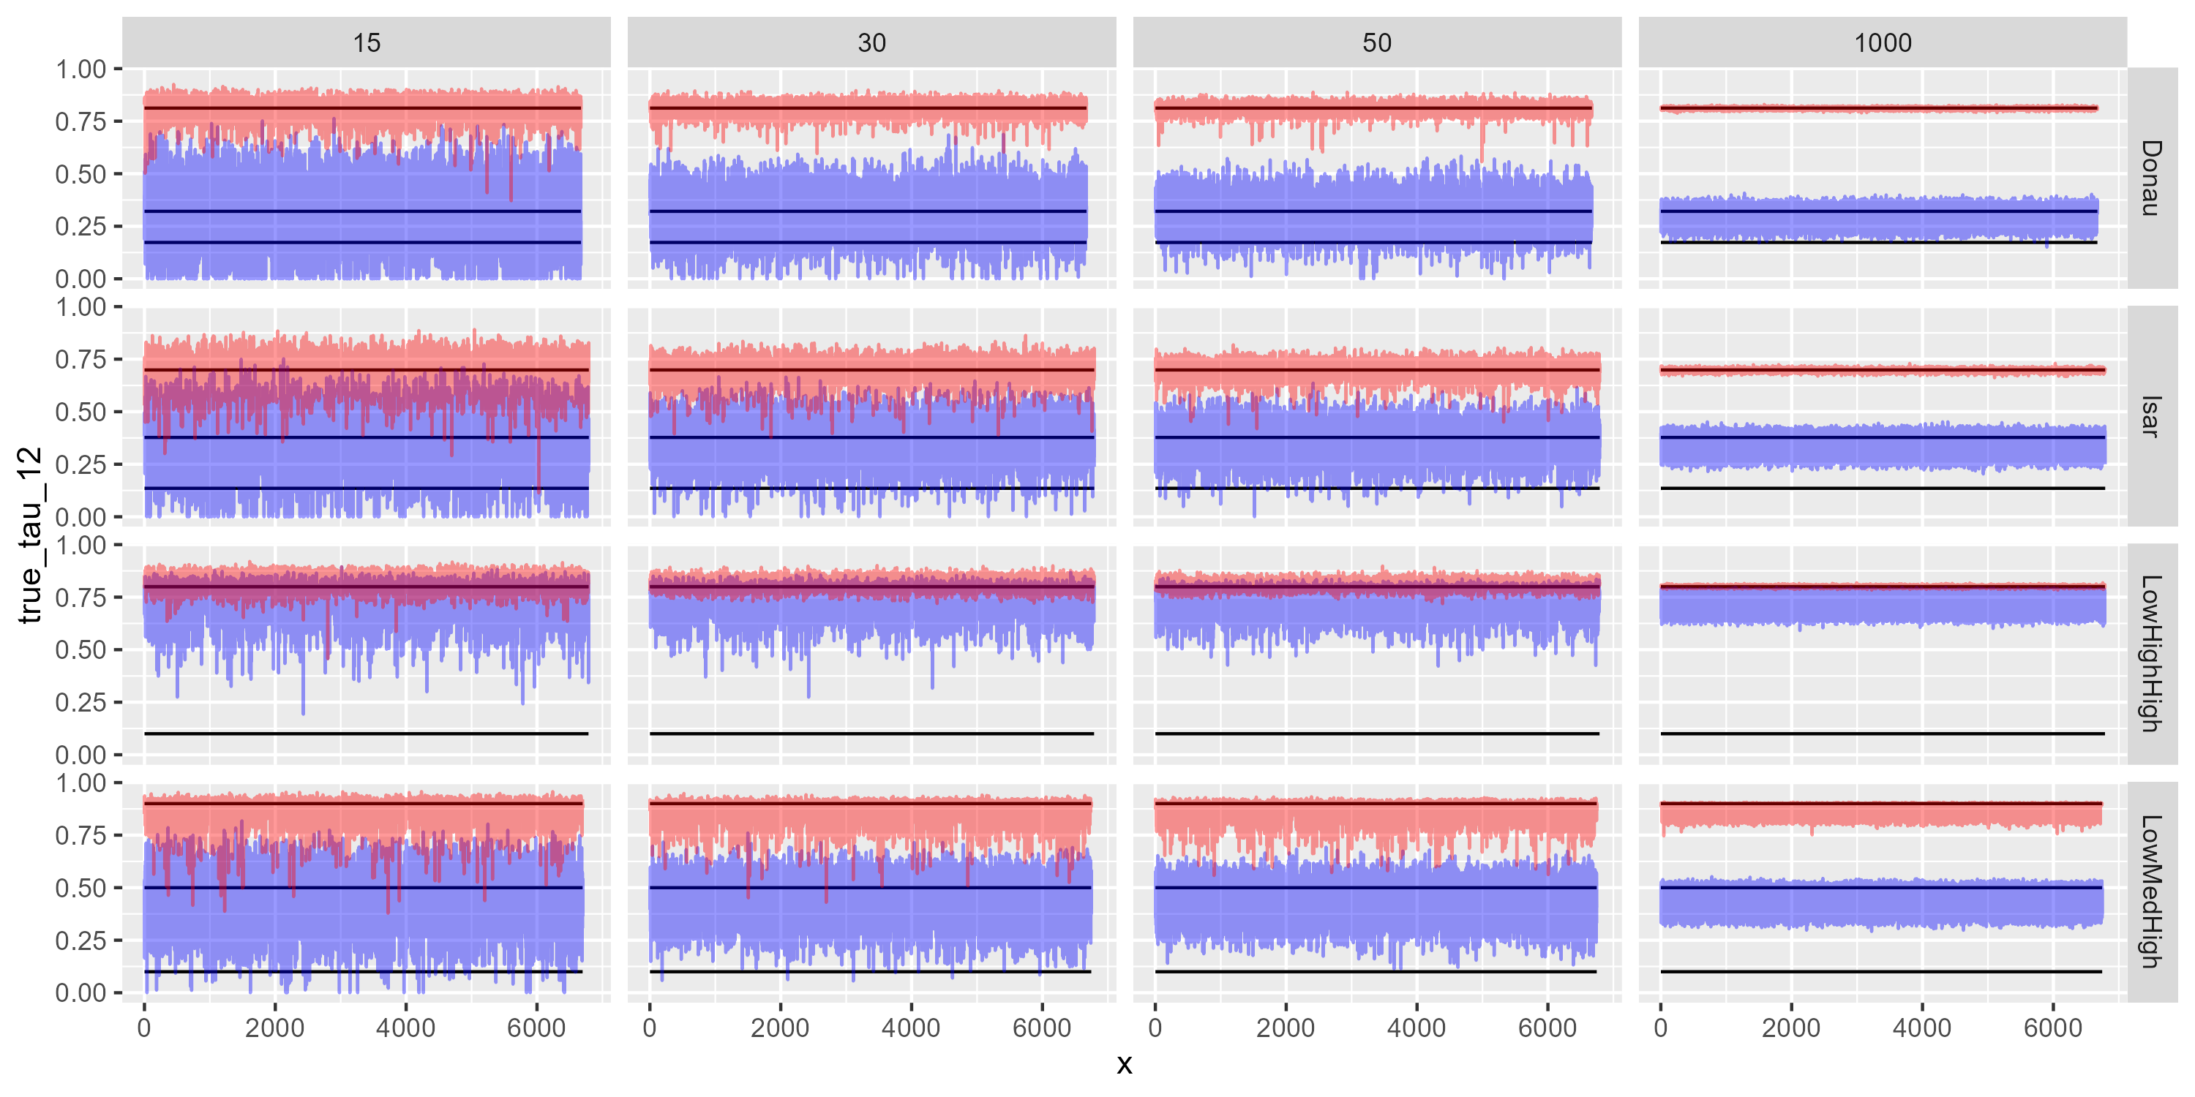
Simulation – Vine DGP
Notes:
- Overestimation NAC

Slide 40
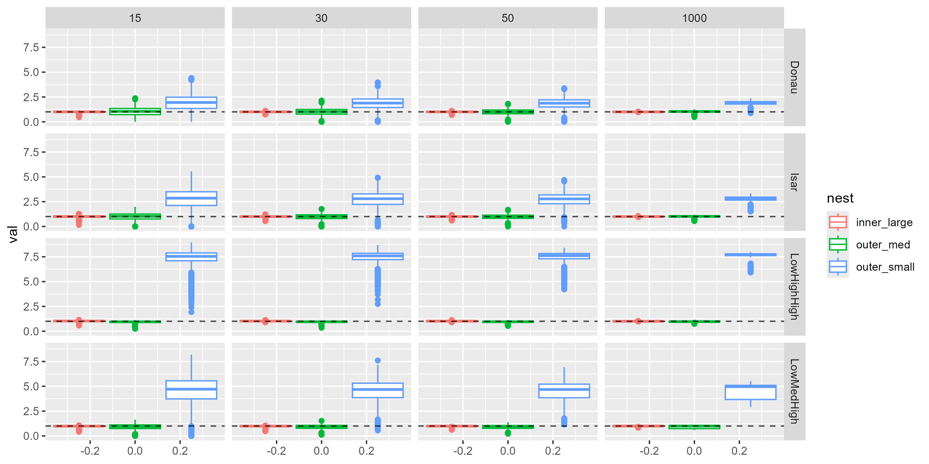
Simulation – Vine DGP
Notes:
- AIC discussion

Slide 41
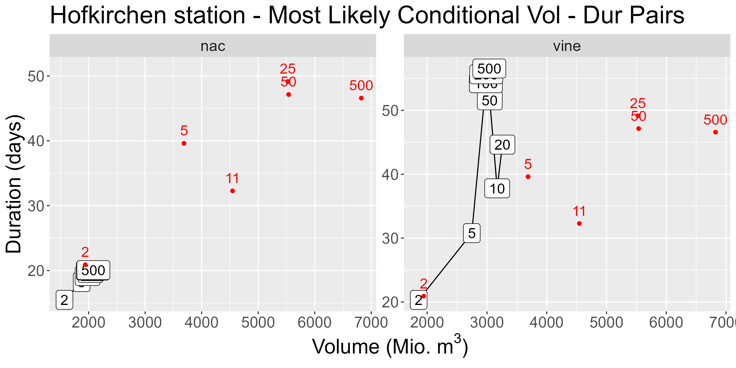
Appendix – The Issue

Slide 42
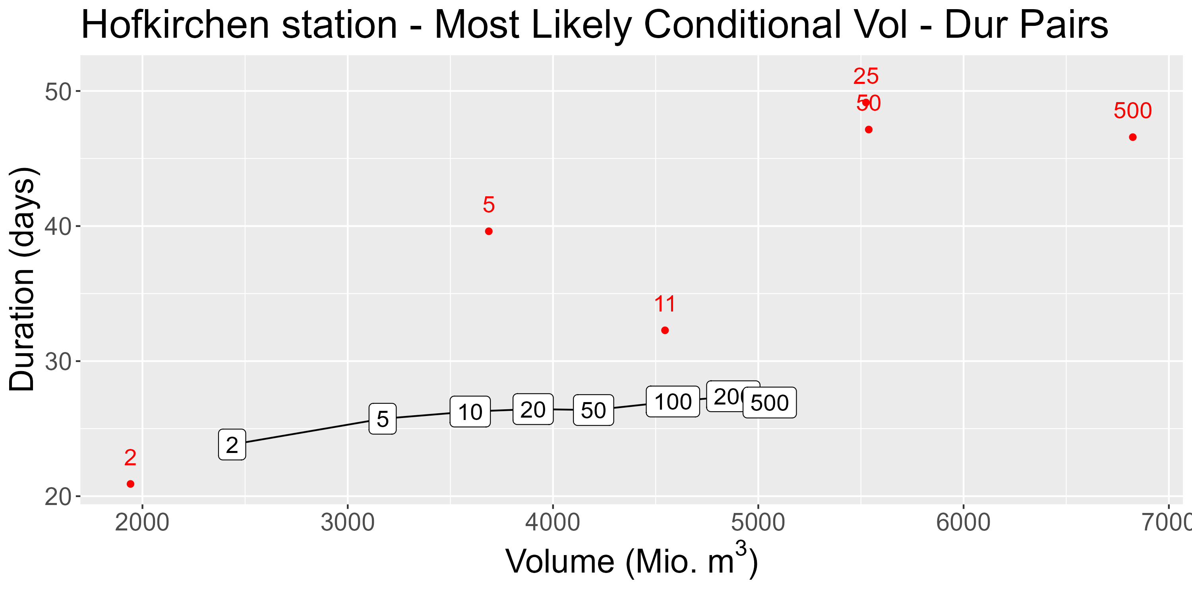
Appendix – The Issue

Slide 43
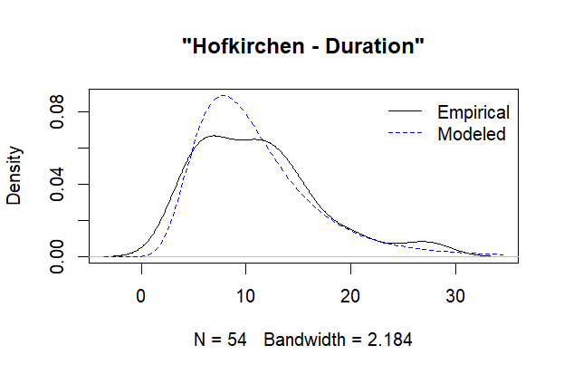
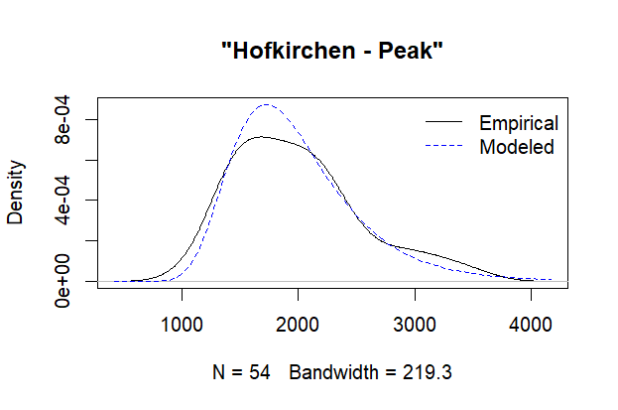
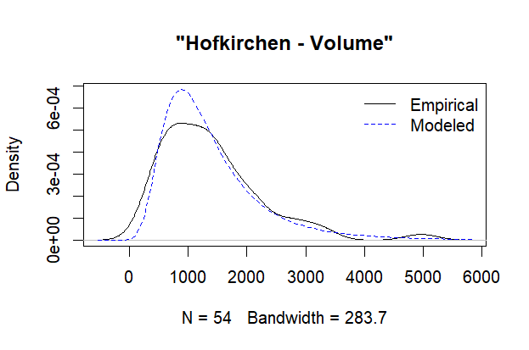
Simulation – Vine DGP
Notes:
- AIC discussion

Slide 44
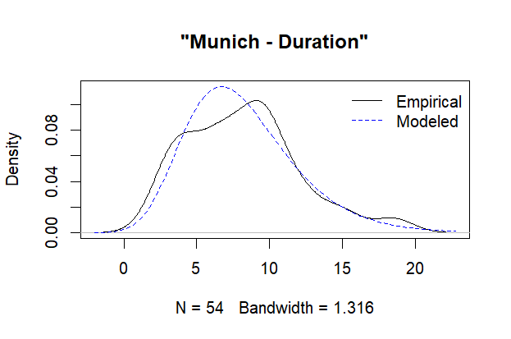
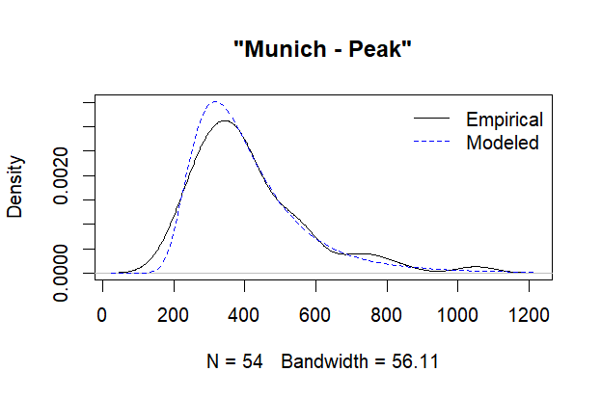
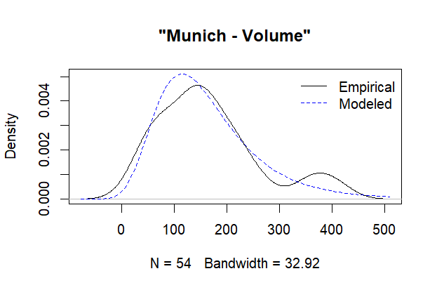
Simulation – Vine DGP
Notes:
- AIC discussion

